Slide 1

Fast and Stable Data and Storage Systems in Milli/Micro-second Era
Mingzhe Hao
Notes:
Hello everyone, thank you for having me. I am Mingzhe Hao, from the University of Chicago. Here, I will introduce my thoughts on building FAST and STABLE data and storage systems in the Milli- or Micro- second era.
15 sec
Total 15

Slide 2


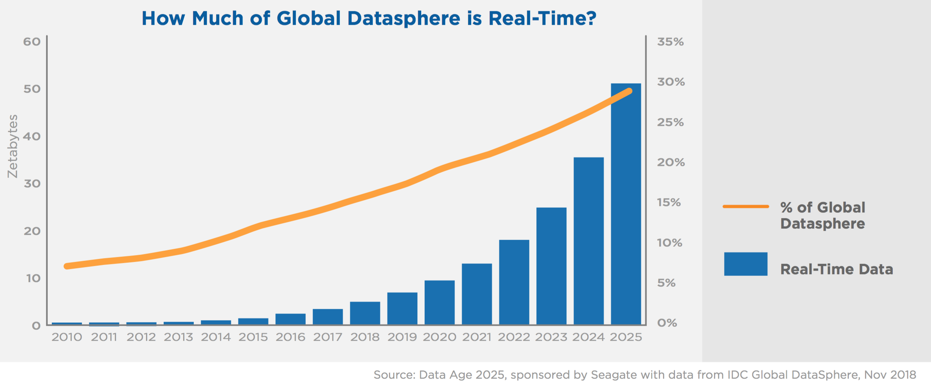
More data, and more in real-time!
Each person will have
one real-time interaction every 18 seconds
Doubling data every 2 years
30 zettabytes in 2018
175 zettabytes in 2025
30% data access will be real-time by 2025
Surging challenge of real-time data service
Notes:
Storage is important as we have big data. Our data is doubling every 2 years, with approximately 175 zettabytes in 2025.
Furthermore, consumers are not only addicted to data, but also more of it in REAL-TIME. By 2025, each connected person is expected to have ONE real-time digital interaction EVERY 18 seconds.
Quantitatively speaking, nearly 30% of our data access will be real-time by 2025. Given that, our storage is facing the surging challenge of serving data in real-time.
41 sec
Total: 56s

Slide 3
The Need for Stability
Time
“In Google, an extra 500ms in search-result generation can drop traffic by 20%”
2006
[Marissa Mayer at Web 2.0]
“In Amazon, every 100ms of latency costs 1% in sales”
[Greg Linden. Make Data Useful]
“In trading systems, a broker could lose as much as $4 million per millisecond
if its platform is 5ms behind the competition”
2008
Offering low and stable latencies
is a significant challenge
[Viraf (Willy) Reporter. The Value of a Millisecond: Finding the Optimal Speed of a Trading Infrastructure]
2014
“Most of the interesting devices that we are dealing with are
in the microsecond-level, and we suck at microsecond-level”
[Google Research: Three things that MUST BE DONE to save the data center of the future]
“A new breed of I/O devices motivates greater interest in
microsecond-scale latencies, and new technologies are needed”
2017
[Attack of the Killer Microseconds, CACM]
Notes:
And these real-time data accesses highlight the need for low and stable latencies.
However, unfortunately, our systems do not always fulfill this requirement.
For example, there are 500ms glitches, making google angry as its traffic drops by 20%.
There are 100ms delays, making Amazon unhappy as it loses sales by 1%.
There are 5ms slowdowns, making brokers heart-broken as they lose 4 million dollars.
And now there are microsecond-scale interruptions, making researchers call for new technologies.
So these days, even MICROSECONDS of DELAY is critical.
Overall, offering Low and Stable latencies is becoming a more significant challenge.
50 sec
Total:106s

Slide 4
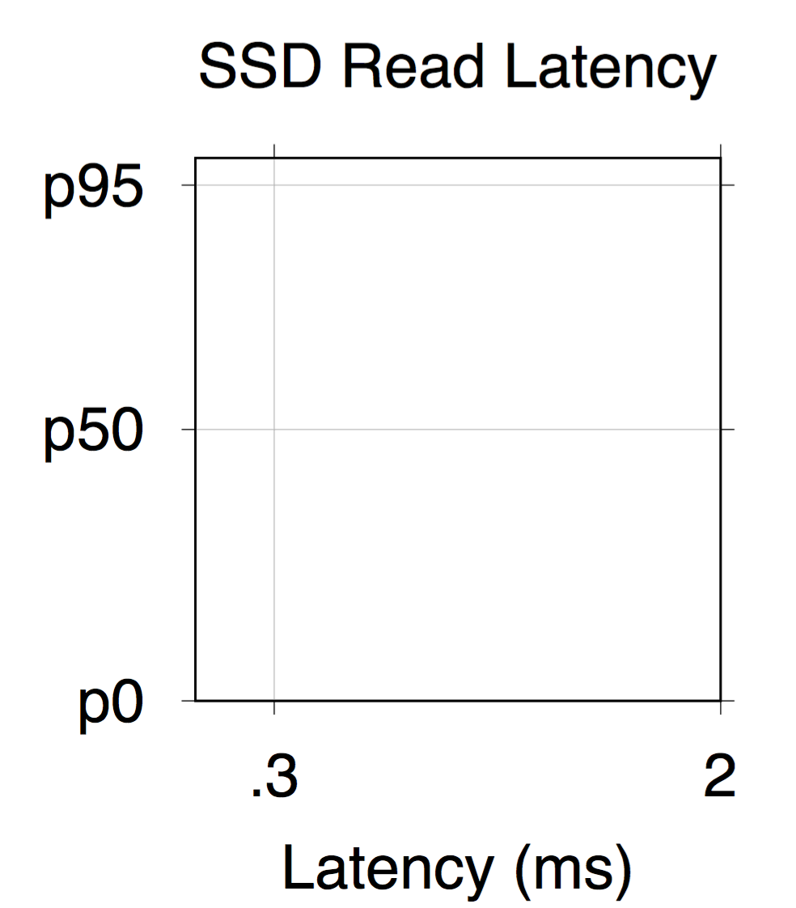

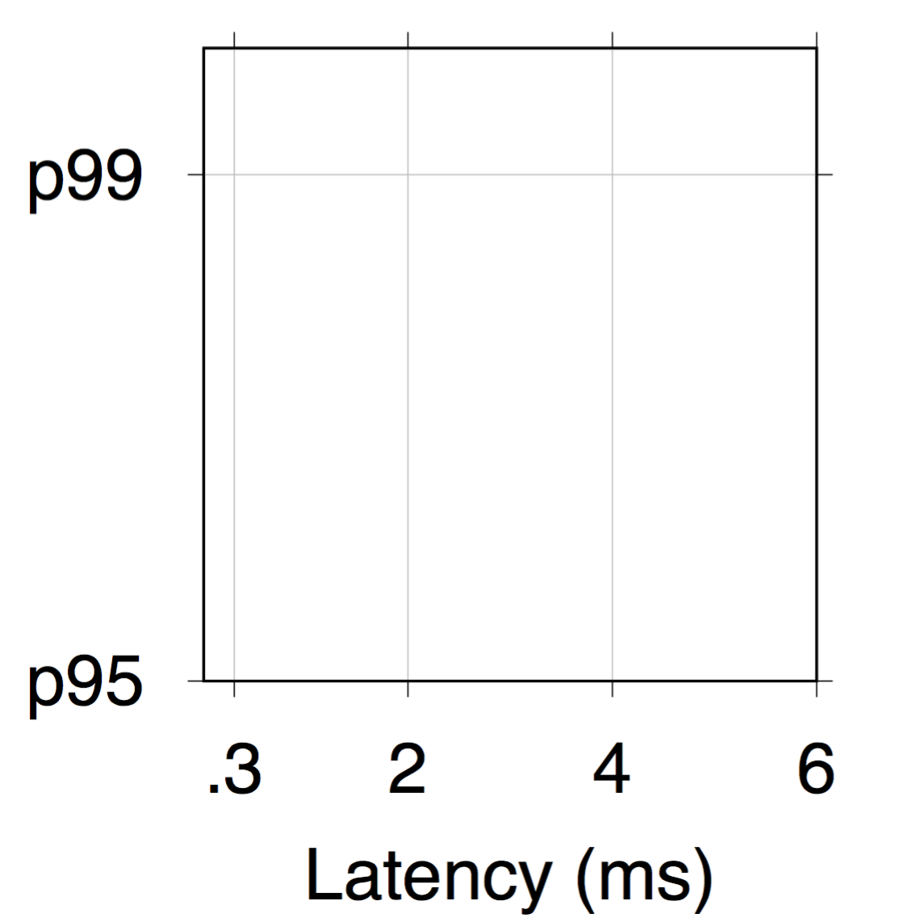

Instability (in CDF graphs)
Stable!
“Tail-free”
Tail
latencies
95% < .3ms
5% > .3ms – 10ms
Notes:
Let’s put this problem on graphs. Nowadays, to depict performance instability in systems, we usually use CDF figures.
(fast) Here is an example. The x axis is the latency in millisecond, and y axis is the percentile. I use “p” here for abbreviation.
As shown here, typically we are good, as 95% of the latencies are under .3 millisecond.
But things can become muuuuuuch worse after that. If we zoom into the top, we can see that the slowest 5% are much worse. As the shape looks like a tail, we also call these worst latencies the “TAIL LATENCIES”.
And Ideally, we want to be here, where every response is rapid and the system is STABLE and TAIL-FREE.
49 sec
Total: 155s

Slide 5





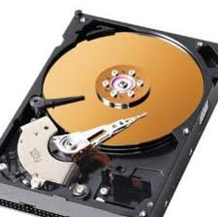
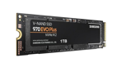
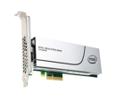
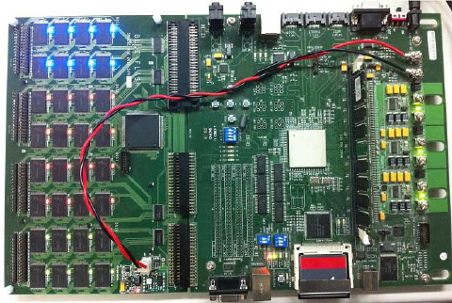
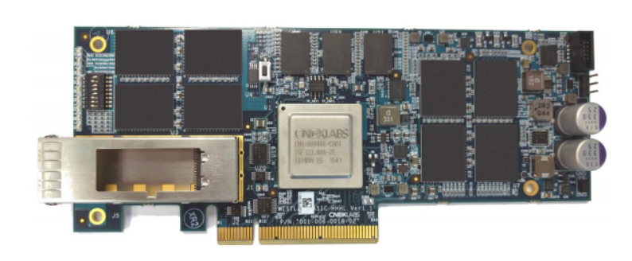
Reasons Behind Tail
User Applications
Unhappy
users
Happy
users
…
User-level Software
…
Sharing
Resources
Operating Systems
Rapid
responses
Slow
responses
…
Hardware Devices
Resource
contention
…
Notes:
So the goal is quite straightforward, then why it is difficult? It is because modern systems are COMPLEX with multiple layers.
For example, there are user applications such as search engines, online shopping etc.
And through user-level software, the requests are routed to underlying resources, managed by operating systems, and supported by hardware devices.
IN THIS COMLPEXITY, resources are usually shared, which can cause INTENSIVE contentions, SLOW responses, and SAD users.
And my Goal is to help these systems achieve RAPID responses, and make users happy.
45 sec
Total: 200s

Slide 6
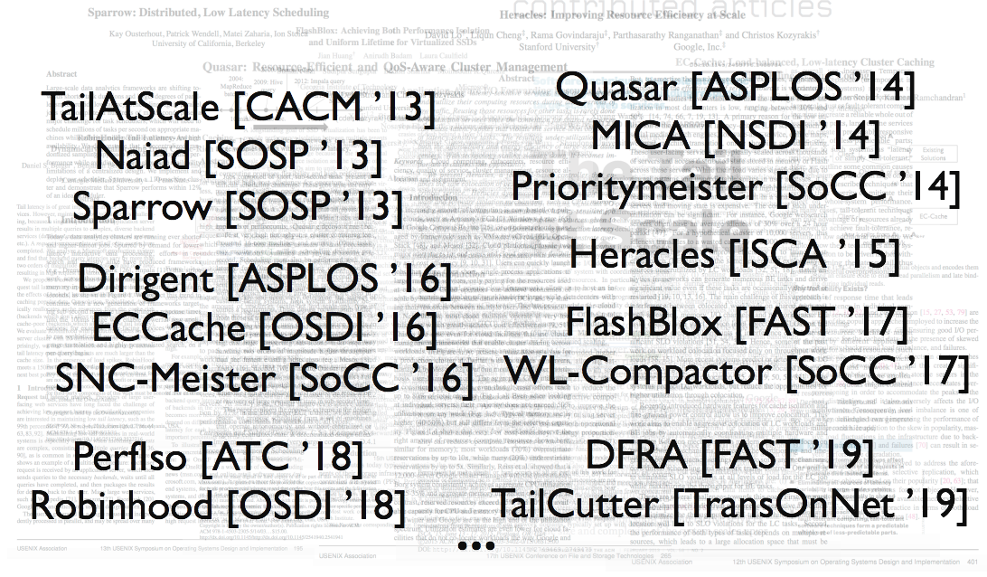
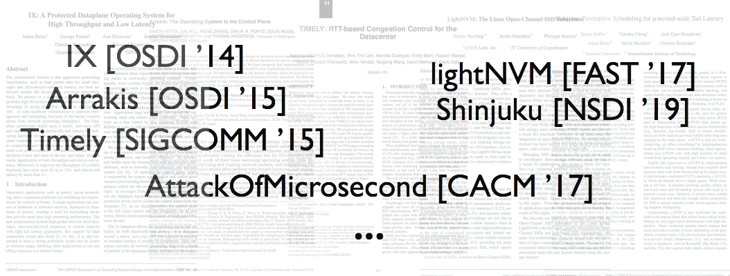
Hard Problem
Upper layers
Applications
Many Related Works
Cluster control
User Applications
…
Task scheduling
User-level Software
…
Networks
Process managements
Resources
Lower layers
…
Operating Systems
…
Storage???
Hardware Devices
Not many
…
Notes:
This problem is so important that many people have tried to tackle it in different layers.
There are many works in the upper layers, and MUCH LESS, in the lower layers.
These works raise contributing ideas on various parts such as applications, cluster control, task scheduling, networks, process managements etc.. There are some works on storage, but not many, and that is where I work on.
30s
Total:230s

Slide 7
My Work
User Applications
…
User-level Software
…
Focus: Data and
Storage Systems
Resources
Operating Systems
…
Hardware Devices
…
Notes:
so My works focus on DATA and STORAGE systems, the HOME of DATA, and my research covers operating systems, hardware devices, and user-level software layers.
14s
Total:244s

Slide 8
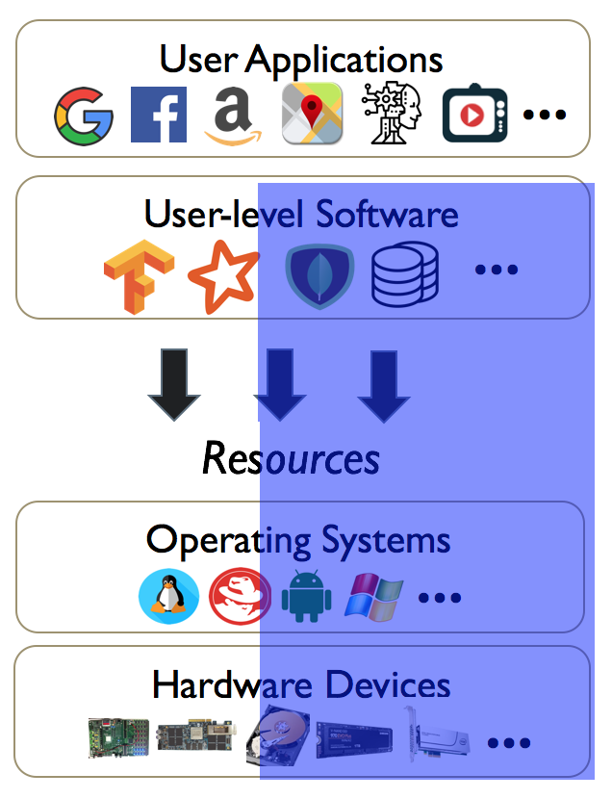
Cutting Tail in Data and Storage
ML-for-system Approach
OS-level Approach
Hardware-level Approach
Low and stable
latencies
Data Approach
Notes:
Cutting tail in data and storage is NOT EASY , as it involves MULTIPLE layers with COMPLEX hardware and software components. Considering that, I take a DEEP and BROAD view of this challenge, and tackle it with NOT ONLY ONE approach,
but MULTIPLE approaches, including data, hardware-level, OS-level, and ML-for-system approaches.
26 sec
Total:270s

Slide 9


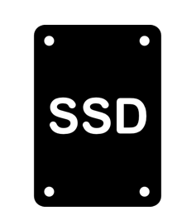
Data Approach
Do tails exist? How severe?
ML-for-system Approach
First, largest tail study
in storage devices
TailAtStore [FAST ’16]
OS-level Approach
~900M
drive hours
perf. log
Disks have tails; SSDs are worse
Caused by resource contentions
and internal complexities
Tail latencies are becoming more
prevalent, intrinsic, and heavy
Hardware-level Approach
Data Approach
450k+
HDDs
4k+
SSDs
Notes:
At high-level, my data approach answers two key questions: Do tails exist? And how severe are they?
Here, I reached out to a large storage company and conduct the FIRST, LARGEST study on tail latencies in storage devices.
This study covers performance log in more than 450 thousand hard drives and 4 thousand SSDs for totally around 900 million drive hours, and mainly reveal three observations:
First, disks have tails, and SSDs are even worse.
Second, this instability is mostly caused by resource contentions and internal complexities
And overall, as systems adopt faster storage devices, tail latencies are only becoming more PREVALENT, INTRINSIC, and HEAVY
54s
Total: 324s

Slide 10
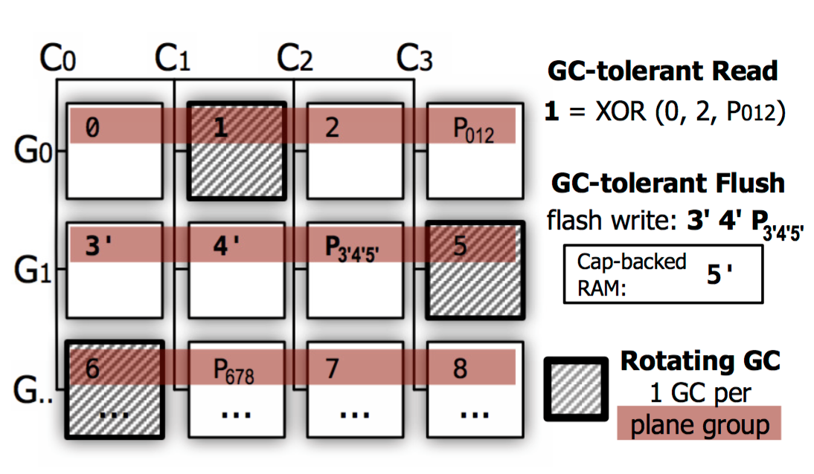
Hardware-level Approach
Can hardware become “tail-free”?
ML-for-system Approach
OS-level Approach
Tail-free SSDs and flash-arrays
Tiny-Tail Flash [FAST ’17], TeaFA [InSubm ’20]
Utilize internal data redundancy
to reconstruct slow I/Os
No more slow IOs
Stable and “Tiny-Tail” latencies
Hardware-level Approach
Internal knowledge
allows for actions beforehand
Data Approach
Notes:
So, there are heavy tails in hardware. Then can we just solve the issue in hardware layer and make it “tail-free”?
And indeed solutions at hardware-level can be very effective. Since the hardware devices know about the internal disruptions, they can take actions beforehand to help evade performance disturbance.
Here, we (try on SSDs and )successfully re-architect SSDs and flash arrays that promptly utilize internal data redundancy to reconstruct the slow IOs. So these devices have no slow IOs and show stable and “TINY-TAIL” latencies.
44sec
Total:368s

Slide 11

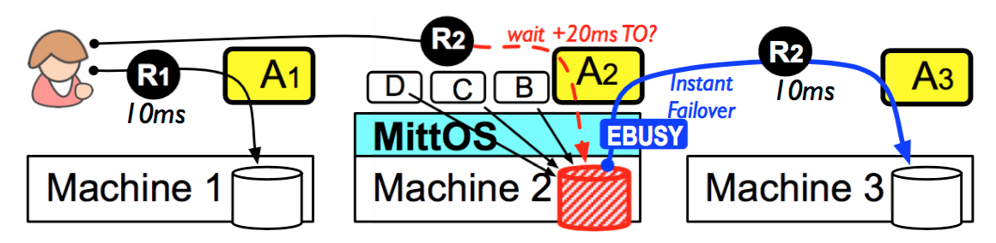

OS-level Approach
A more generic solution?
ML-for-system Approach
Datacenter-aware OS
MittOS [SOSP ’17]
Allows apps to know expected latency of every single I/O
Applications can failover to less-busy replicas with minor cost
Outperforms latest industry solutions
OS-level Approach
Apps
Hardware-level Approach
Apps
Data Approach
Notes:
Our hardware-level approach can dramatically improve tail performance, but it requires specialized hardware and is ignorant about the global setup. So can it cover MORE hardware and application settings?
To achieve that, I take OS-level Approach and develop MittOS, a datacenter-aware operating system that advocates PERFORMANCE TRANSPARENCY.
With MittOS, applications can know the EXPECTED LATENCY of EVERY SINGLE IO,
and take instant failovers to less-busy replicas with minor cost, OUTPERFORMING the latest industry solutions.
45secs
Total: 413s

Slide 12
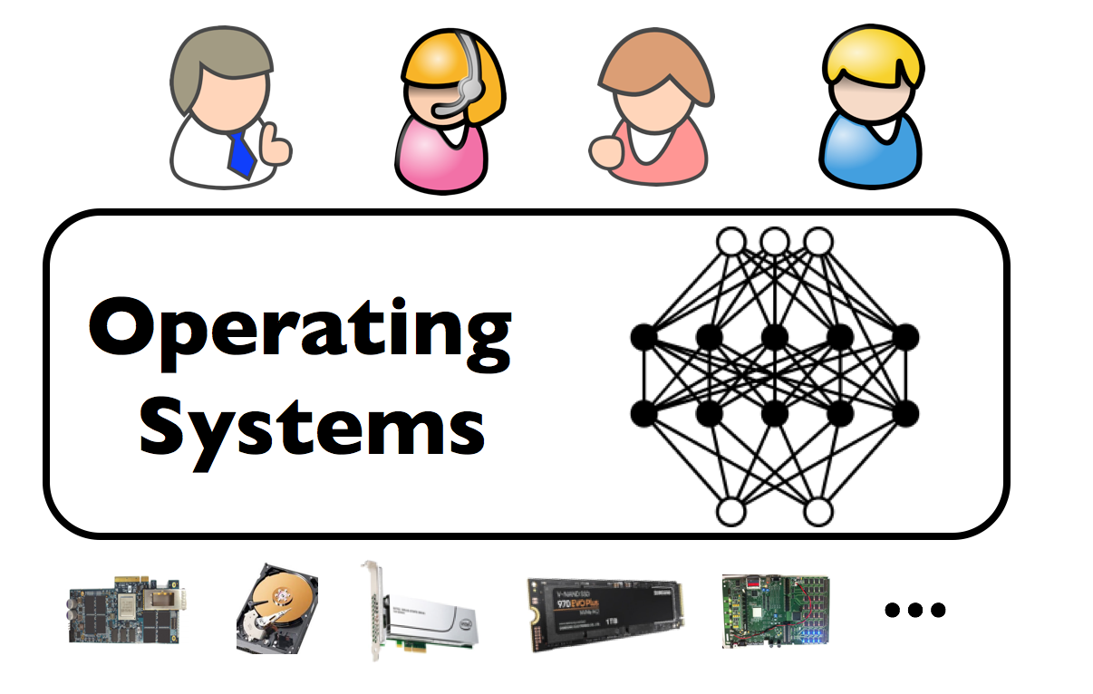
ML-for-system Approach
A more and more generic solution?
ML-for-system Approach
Uses I/Os as learning dataset
Predicts tail latency occurrences for every single IO, on most SSDs
Achieves great accuracy on industrial workloads
With low overhead on CPUs
Apps
…
MLOS
[ToSubm ’20]
OS-level Approach
Apps
…
Hardware-level Approach
Apps
…
Data Approach
Notes:
So MittOS promotes transparency but it does not support all SSDs, can it be extended to GENERICALLY cover major commercial SSDs?
Yes it can. As nowadays systems receive MILLIONS and BILLIONS of I/Os per second, the I/Os THEMSELVES assemble a VALUABLE dataset,
Which gives machine learning a GREAT ASSET to learn.
So here, I take ML-for-system approach, and develop MLOS. By learning the (history) I/Os with LIGHTWEIGHT neural network, MLOS can
predict tail latency occurrences for every single IO, on most SSDs,
achieve GREAT accuracies on industrial workloads, and brings low overhead on CPUs.
53 sec
Total: 456s

Slide 13
Goal: Building “tail-free” data and storage systems
“Tail-free”
Goal achieved!
…
ML-for-system Approach
Apps
OS-level Approach
Apps
More effective and generic
Hardware-level Approach
Data Approach
Notes:
Overall, I build “TAIL-FREE” data and storage systems at MILLI-/MICRO-second scale.
As I try to make my works more EFFECTIVE and GENERIC, I take multiple approaches at different levels.
And through these approaches, I make storage systems “tail-free”.
21sec
Total: 477s

Slide 14
Other works
Goal: Building “tail-free” data and storage systems
Focus
(System availability and reliability)
…
ML-for-system Approach
Apps
MLOS
[ToSubm ’20]
Queenie
[InSubm ’20]
OS-level Approach
Limplock
[SoCC ’13]
SAMC
[OSDI ’14]
Apps
MittOS
[SOSP ’17]
LeapIO
[ASPLOS ’20]
More effective and generic
Hardware-level Approach
ttFlash
[FAST ’17]
TeaFA
[InSubm ’20]
FEMU
[FAST ’18]
CloudBug
[SoCC ’14]
CloudOutage
[SoCC ’16]
Data Approach
TailAtStore
[FAST ’16]
FailSlow
[FAST ’18]
Notes:
Here I list my correlated works.
Meanwhile, I have also worked on system availability and reliability, and helped publish some interesting papers.
Due to limitation of time, I will not go through all of my works.
Next I will slightly touch TailAtStore and Queenie, while focusing on MittOS and MLOS, as they are the best to represent my principles in building “tail-free” systems, and then I will talk about my future plan.
36 sec
Total: 513s

Slide 15
Millisecond Tail Tolerant OS Performance Transparency via Deadline-aware Interface
Notes:
Now I will introduce how MittOS supports millisecond tail tolerance with deadline-aware interface.

Slide 16
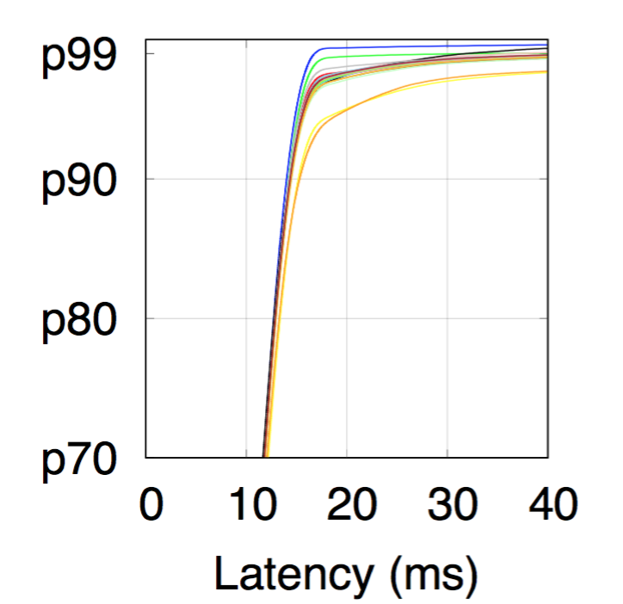
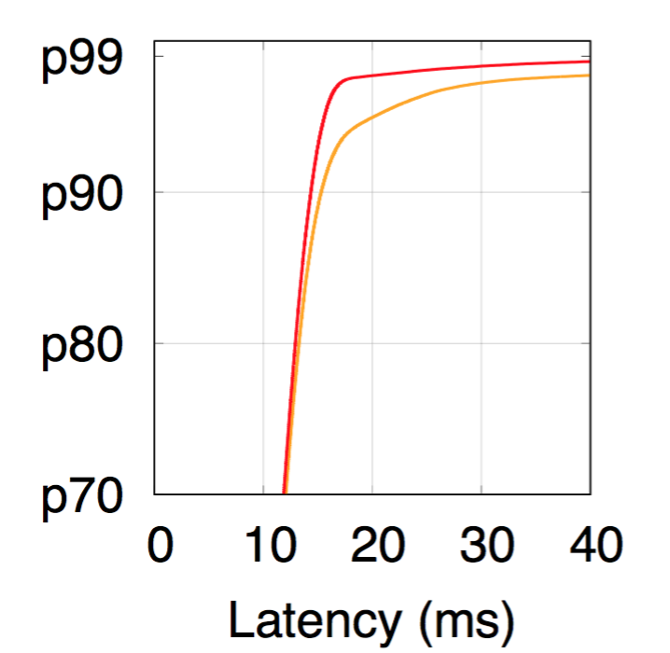
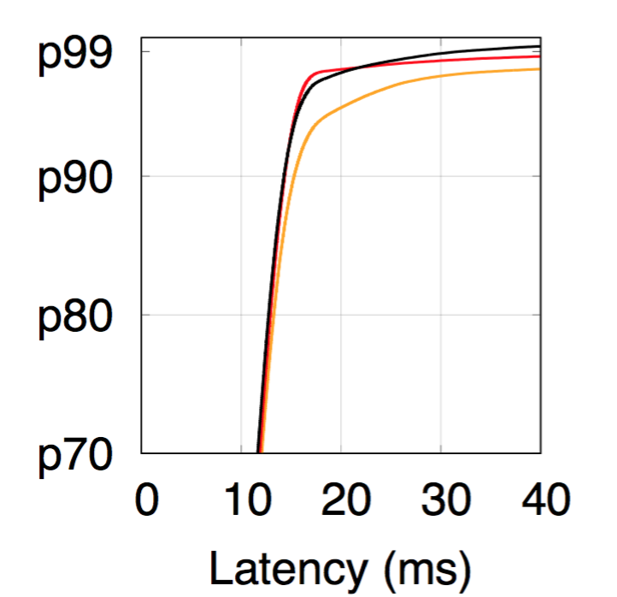
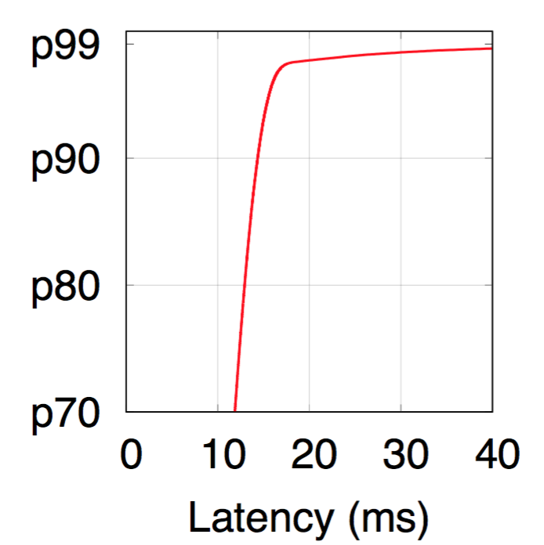
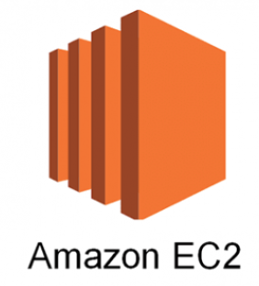
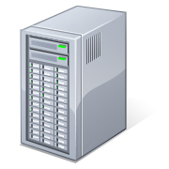

We need a data service.
Let’s try public cloud.
Tail with millisecond-level dynamism
Slow responses!
40 – 500ms
Up to 40x
…
~12ms
5 workdays
8 hours/day
10 reqs/sec
Notes:
Let’s say we want to deploy a data service. We start with public cloud service as it is simple.
We run a node for 5 workdays, 8 hours a day. The workload intensity is low, say roughly about 10 requests per sec, so one medium instance should be good (able to provide decent performance).
However, it turns out that (there are ) customers complain about slow responses. So we look into the request latencies, and this is what we have.
There is millisecond-level dynamism as most (of the) requests show around 12ms latency, while the top 10% can be (as slow as 40 to 500ms,) up to 40x slower.
Maybe we are just unlucky and get a slow node, so let’s try another node…
Okay there is still tail, let’s try again... again... It just doesn’t work

Slide 17
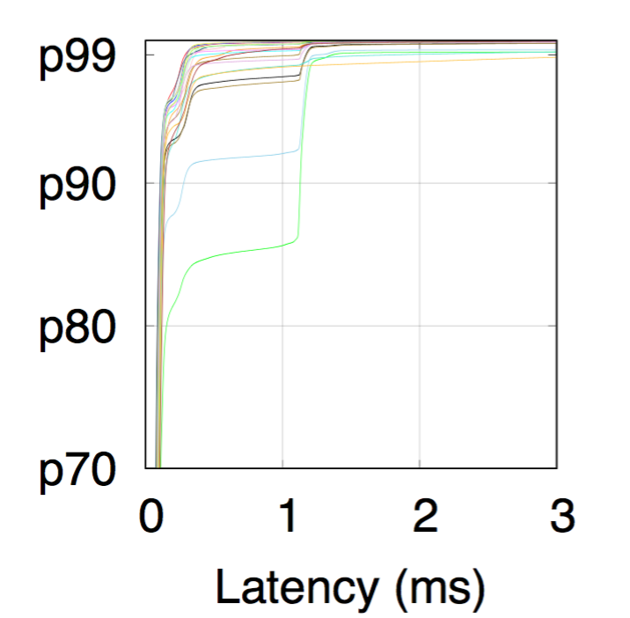
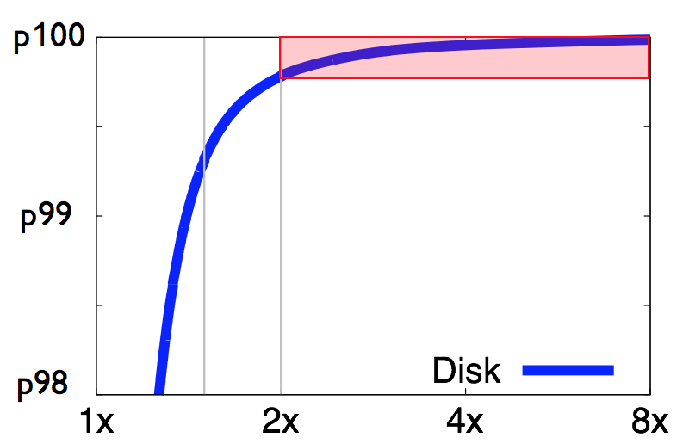
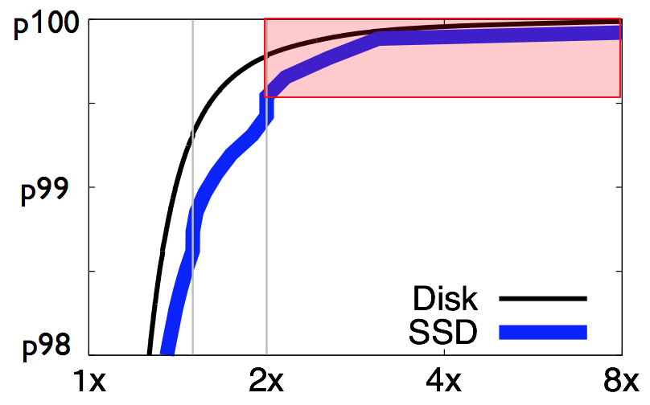
Disk-based
SSD-based
Tail with microsecond-level dynamism
1 – 125ms
Up to 400x
~0.3ms
Tail is everywhere!
Disk-based
SSD-based
TailAtStore
[FAST ’16]
Over 450k disks and 4k SSDs
Over 800M drive hours
Enterprise-level
Storage
Notes:
Okay maybe it is because we were using disk-based nodes. Let’s upgrade to the ones with SSDs and see.
Still not good as we see microsecond-level dynamism. The service does go faster as most latencies drop to 0.3 millisecond, but tail can reach up to (125ms, which is) 400x slower.
Okay, it seems that cloud service cannot fulfill our requirement. How about enterprise-level storage?
With the hope that these storage will be fast and stable, I conduct a study of over 450k disks and 4k SSDs in enterprise-level storage, covering more than 800 million drive hours, and here is what I have found.
Tail, tail never changes. It is everywhere.

Slide 18

The Problem: Tails (Stragglers)
Parallel
task #1
10ms
…
Parallel
task #2
30ms
IO contention
Completion
30ms
Notes:
Let me summarize, with the tail we have just seen, if a job sends two parallel tasks to two servers. Regularly servers can respond fast, say within 10ms.
However, due to IO resource contention (between different tenants, which is common in cloud environment, )
sometimes a server can show slow response, and spend 30ms.
In this case, the job will be hindered by the slow server and get tail latency as well(, which is 30ms.)
32sec
Total: 772s

Slide 19
Popular Tail-Tolerant Approaches
1. Speculation
2. Cloning
Introduces 2x workload
Most popular
Straggler!
3. Snitching/Monitoring
Does not work when burstiness fluctuates in ms-level
Wait
Completion
20ms
Backup
Notes:
So how do current tail-tolerant mechanisms work? One popular solution is speculation, where applications wait first, then identify the straggler, and eventually launch the backup task. Though able to be faster, speculation has a major drawback – it has to wait, which is very expensive at millisecond-level.
Cloning can be another choice, but it has to introduce 2x workload.
Snitching, which monitors latencies of servers and picks the fastest replica, does not work when noise has millisecond dynamism.
Overall, speculation is so far the most popular tail-tolerant mechanism.
45 sec
Total: 817s

Slide 20
Must Wait!
No Wait ?
My device is busy!
Try elsewhere
IO Queue
App
MittOS
Wait
or
ok
Fast reject
Completion
20ms
Backup
Failover (no-wait)
Completion
10ms + network-hop
Notes:
So essentially, the most popular approach is to wait-and-see.
Well, can we do better, say without waiting? Yes we can, when IO is sent to OS, and arrives at the IO queue, ACTUALLY the OS can look into the queue and realize device is busy, then fast rejects this IO.
Hearing that, the application can INSTANTLY failover to less-busy replica without waiting, enhancing job latency to 10ms plus a small network hop.
As you can see, this no-wait approach brings much better performance than speculation, and that is how my work MittOS is different.
48sec
Total: 865s

Slide 21
Datacenter-aware via performance transparency
I expect
latency within 20ms. Otherwise try another
PC Era
DC Era
Here is a request
IO Queue
Maybe slow
App
MittOS
Wait
or
Fast reject
Will do my best
Backup
Failover (no-wait)
Notes:
So philosophically speaking, what does MittOS propose? Well, in PC era, when an application sends a request, it does not tell OS about existence of other alternatives. As a result, the OS can only do its best, and applications can only sit there and wait.
But now as we are in the DC era, where data has replicas, OS should become datacenter-aware and support performance transparency.
That means, applications should let OS know their latencies expectations, so OS can instantly reject if the expectations cannot be fulfilled. With that, applications can failover (to other less-busy replicas,) and get fast responses.
49sec
Total: 914s

Slide 22
Use-Case
OS can see “everything” and tell app when it is busy
I want < 20ms latency
App
OS
1
deadline = 20ms
3
IO Queue
2
ret = read(.., deadline)
or
if ( ret == Reject)
// failover
5
4
if (predict lat.
< deadline)
reject
Notes:
And for applications, leveraging rejection from MittOS is easy.
Let’s say an application wants less than 20ms latency, then it just needs to set a latency deadline, tag it into a read request, and pass it to OS.
Once target IO arrives at the queue. The OS can tell app if it’s busy since it can see everything about resource management. If target resource is busy and deadline cannot be met, OS will return fast rejection back to application and trigger the failover (to less-busy replica).
41sec
Total: 955s

Slide 23
Challenge? Prediction!
Challenge:
How to predict latency before submitting to the device?
ret = read(.., < 20ms)
App
OS
Tail
Tail
End of queue.
Reject!
Head of queue.
Accept!
How many
IOs in front?
How long?
Head
Head
Notes:
The process here sounds easy, but actually it is not. As MittOS needs to “predict latency before submitting to the device?”, which can be very challenging. For example, based on queue policy, the IO can be put at the end of queue and get rejected, or near the head of the queue and get accepted.
Or more often, the IO can be put in the middle.
In this case, latency prediction for IO is split into two parts:
First, how many IOs are in front?
And second, how long will they take?
35sec
Total: 987s

Slide 24
Challenge
ret = read(.., < 20ms)
App
How to predict?
OS
FIFO, elevator, CFQ, etc.
What is the OS queue policy?
What is the device type?
How many
IOs in front?
How long?
Prediction needs to model queue policy and device type
Notes:
To answer “how many IOs in front?”, we need to know what is the OS queue policy. For example, we can have (simple) FIFO, elevator, and (complicated) CFQ.
And “how long would they take?” depends on underlying device type. There can be (single-spindle) disk, (parallel-chip) SSD, and (fast) memory.
As a result, the prediction must model underlying queue policy and device type.
31sec
Total: 1018s

Slide 25
To predict latency
1. Modeling the queue policy
2. Modeling the device type
Deadline
< 20ms
Reject / Accept
depends on
queue policy
App
> 20ms
Reject
OS
Low Priority
> 20ms
Reject
50ms
40ms
Outstanding IOs
30ms
High Priority
< 20ms
Accept
20ms
10ms
Elevator
+ CFQ
FIFO
Elevator
Notes:
Our first challenge is modeling Queue Policy.
let’s say each request takes 10ms to process, and target deadline is 20ms.
With FIFO (queue), the IO will need to wait for all IOs ahead to finish, easily taking longer and thus should be rejected.
Elevator queue allows IO to be inserted. In this case, our IO can be inserted near the head of the queue (, thus able to meet the deadline )and should be accepted.
In deployment, the scheduler policy can be more complicated, like Elevator + CFQ. By incorporating priorities, our IO can be preempted( by higher priority ones,) and eventually be rejected.
As we can see, reject or accept depends on queue policy.
56sec
Total: 1074s

Slide 26
To predict latency
1. Modeling the queue policy
2. Modeling the device type
Reject / Accept depends on device type
Parallel channels & chips
FIFO
FIFO
< 20ms
Accept
> 20ms
Reject
Single
spindle
Disk
…
Notes:
The next challenge comes from device type.
For example, disk has single spindle and can only serve requests one by one, resulting in slow response for IO at the tail.
While in SSD, there are multiple parallel channels and chips. In this case, the IO can get fast response even it sits at the end of the queue.
Therefore, reject or accept also depends on device type.
30sec
Total: 1104s

Slide 27
To predict latency
1. Modeling the queue policy
2. Modeling the device type
Idiosyncrasies of devices are mostly unrevealed
End of queue!
Reject?
IO Offset
Elevator
OS prediction incorrect!
200
OS prediction incorrect!
OS
700
OS
Too many!
Reject!
600
250
SSTF
700
600
Re-sort, thus fast,
Accept!
200
Remap to fast chip, Accept!
…
Scheduling algorithm
250
Notes:
Devices can bring another challenge. That is, idiosyncrasies of devices may cause different views of latencies between OS and devices.
For example, the OS can reject target IO because there are too many IOs in front, while disk may (apply another scheduling and )re-sort target IO, giving it a fast response. In this case, prediction from OS will be incorrect.
The same stands for SSDs. For example, OS may see target IO at the end of the queue and reject it. However, the SSD may disagree, as target IO can be remapped to fast chip where there are few IOs.
As a result, the OS prediction will again be incorrect.
52sec
Total: 1156s

Slide 28
Latency/Reject Prediction
Model from source-code.
e.g. CFQ, noop
Latency & Reject?
=
f ( )
deadline,
queue policy,
device type
MittCFQ
MittSSD
CFQ +
FIFO +
Open-SSD
Notes:
Overall, at high level, latency prediction for an IO and whether to reject it is a function of 3 parameters: Deadline, queue policy, device type.
Queue policies (such as CFQ and noop ) are mostly open-sourced with OS. Therefore it is doable to understand their logics and implement predictions.
However, we just saw that devices can have a different view, so we need to bundle them together in the prediction.
In the next few slides, I will introduce MittCFQ as solution example for CFQ scheduling with disks and MittSSD for FIFO with Open-Channel SSDs.
45sec
Total: 1201s

Slide 29
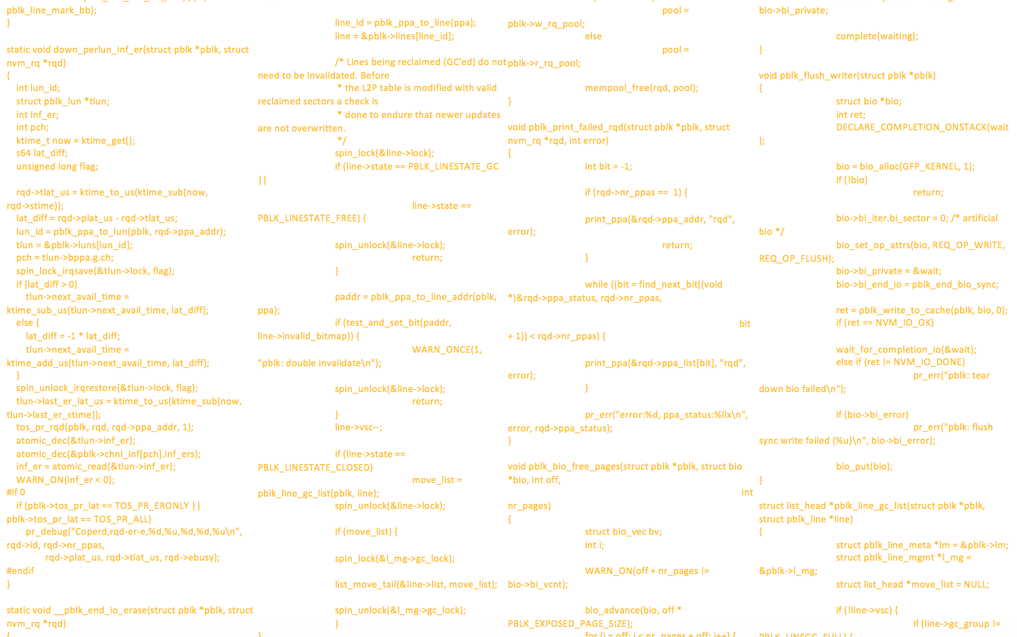
Latency/Reject Prediction
1. MittCFQ (CFQ + disk)
2. MittSSD (FIFO + OpenSSD)
Contains user group management
Contains 3 service trees
Contains 7 different IO priorities
Contains ~4500 LOC
Open-sourced
Reverse engineer
Which tree/queue each IO belongs to? How many IOs in front?
CFQ
OS
Disk Scheduling?
Seek latency?
(depends on seek distance)
Black box
Transfer time?
(depends on IO size)
Notes:
In MittCFQ, OS applies Completely Fair Queueing. It contains user group management. it contains service trees. It contains different IO priorities. And it contains about 4500 LOC in total due to its sophisticated logics.
But, it is open-sourced. So everything can be reverse engineered to know where each IO belongs to and how many IOs are in front.
The real challenge comes from underlying disk, which again is a black-box.
We need to know first, what is the scheduling algorithm.
Second, how seek distance affects seek latency.
Third, how IO size affects transfer time.
45sec
Total: 1246s

Slide 30
Latency/Reject Prediction
1. MittCFQ (CFQ + disk)
2. MittSSD (FIFO + OpenSSD)
For each interval in [ 100MB, 200MB, ..., 1GB ] do:
for (startOffset = 0; startOffset < maxOffset; startOffset += interval) {
for (endOffset = 0; endOffset < maxOffset; endOffset += interval) {
for (size = 0; size < maxSize; size += sizeInterval){
start_ts = gettimeofday();
seek (startOffset);
read (endOffset, size);
end_ts = gettimeofday();
latency = start_ts - end_ts;
print (endOffset - endOffset, size, latency);
}
}
}
Disk Profiling
Random seek
Random read
Collect latency
scikit-learn
2 disk models
11-hour profiling
+ concurrent IO profiling
Latency
Linear Regression
Infer
SSTF
scheduling
IO Size
Seek Distance
1 million entries
(30MB memory overhead)
For 1TB drive
Accurate prediction
Notes:
Based on that, we do a simple profiling, which does a random seek, then reads at another random offset, and collects latency. This process is repeated until all offsets and sizes are covered. (We did the profiling for 2 disk models, and for each model it took 11-hour.)
By training these data with linear regression, we can get a 3D profile map where x is seek distance, y is IO size, and z is expected latency. Also by concurrent IO profiling, we can learn the disk scheduling.
Combing the map and disk scheduling, the OS would be able to predict IO latency accurately.
46sec
Total: 1292s

Slide 31
Latency/Reject Prediction
1. MittCFQ (CFQ + disk)
2. MittSSD (FIFO + OpenSSD)
Which channel/chip? Fast? Busy?
FTL invisible to OS!
OS
FTL
Write lat.
variability
Fast?
Busy?
Too complex to model!
1ms
2ms
Lower MLC bits
Pages
1ms
Invisible dynamic GC
1ms
2ms
Upper MLC bits
1ms
2ms
Notes:
Now let’s take a look at SSD, which has more complicated structure.
So given an IO, can OS know whether it would be fast or busy? The answer is unfortunately no, since SSD uses internal features such as FTL and Garbage Collections, which are invisible to OS.
Not to mention other sophisticated idiosyncrasies. For example, pages at different bits of a cell can show different write latencies.
Therefore, for now we set black-box SSD aside as it is too complex to model.
37sec
Total: 1329s

Slide 32
Latency/Reject Prediction
1. MittCFQ (CFQ + disk)
2. MittSSD (FIFO + OpenSSD)
OS can make accurate predictions
OS can track every single IO
FTL exposed to host
OS
OS knows page-level latencies
FTL
Software-defined flash
Fast?
Busy?
OS can capture all GCs
1ms
2ms
Pages
1ms
1ms
OpenChannel SSD
2ms
1ms
2ms
Notes:
So what can we do? Well if things don’t work with Black-box, then let’s try the White-box approach. (Good news is, for SSDs, software-defined flash is gaining more popularity. )
For example, Open-Channel SSD exposes the whole FTL management to host. As a result, OS can (know where IOs are mapped and )track every single IO on SSD. Furthermore, OS can also capture all GCs, and knows about page-level latencies.
Overall in this case, OS can make accurate predictions.
(see the IOs to every chip/channel, and)
44sec
Total: 1373s

Slide 33
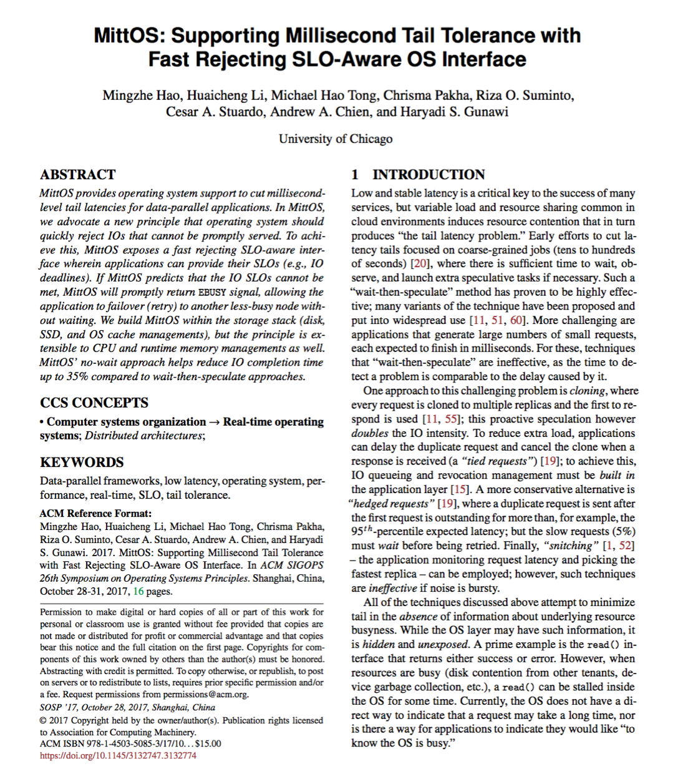
Other Solved Challenges
Prediction overhead optimizations
Avoids going through every IO in the queue
Reduces overhead from O(n) to roughly O(1)
Shows < 5μs overhead for MittCFQ prediction
< 300ns for MittSSD prediction
MittCache
Prediction for OS Cache
Please
refer
to MittOS
paper!
Notes:
(quickly go through)
Before moving on, please allow me to quickly go through other solved challenges.
For prediction, we avoid high overhead from going through every IO, reducing overhead from O(n) to roughly O(1). With that, we achieve < 5 microseconds overhead for MittCFQ prediction, and < 300 nanoseconds for MittSSD.
Also, we implement prediction for OS Cache, called MittCache.
You can read MittOS paper for more detail if interested.
31sec
Total: 1404s

Slide 34


Implementation
Evaluation
+50 LOC only
MittOS-powered
Fast Reject Interface
vs. state of the art: hedged requests, cloning, application timeout, etc.
MittOS Latency Prediction
Disk
Open-Channel
SSD
OS Cache
Notes:
To evaluate how various resource managements can adopt MittOS principle. We implement latency prediction for disks, open-channel SSDs and OS Cache, and expose a fast rejection interface for applications to leverage.
This interface can be easily exploited by applications such as MongoDB and Riak, with only 50 additional LOC for each.
For evaluation we compare MittOS with current state of the art, including hedged requests, cloning and application timeout.
34sec
Total: 1438s

Slide 35
MittCFQ-powered MongoDB
YCSB
benchmark
Metric:
CDF of all get()
requests latencies
(total 6 million
data points)
Client #1
…
Client #2
Client #20
Can failover
get()
get()
get()
3 replicas
…
Noisy neighbors based on EC2 data
Physical node #1
Node #2
Node #20
Notes:
Now let’s see how MittOS help applications cut millisecond tail. Due to time limitation I will focus on MittCFQ-powered MongoDB.
For evaluation, we set up a 20 physical-node MongoDB cluster. Each node has a remote YCSB client sending get() requests to it, and runs a noise generator to emulate noisy neighbors on EC2.
The data is replicated 3 times so clients can failover( to other replicas). From each client, we collect latencies of every single get request as input(, totally 6 million, )and use their CDF as major metric.
40sec
Total: 1478s

Slide 36
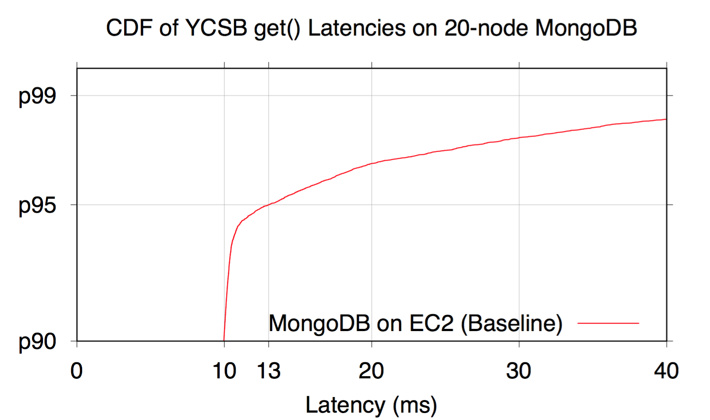
Baseline
Better!
13ms
at p95
> 40ms above p98
CDF (percentile)
Next slides: use
13ms deadline
for Hedged & MittCFQ
90th percentile
Notes:
Our first line is base case, where no action is taken against tail. Again this is a CDF figure. The x axis is latency in millisecond, and y axis is CDF percentile. Please note that it starts from p90 since we focus on the tail. Lines close to the upper left indicate better performance.
As we can see, the tail is quite severe. We have more than 40ms at p98, and 13 millisecond at p95. Based on this observation, we set deadline = 13ms for other policies, including hedged requests, and MittCFQ.
34sec
Total: 1512s

Slide 37
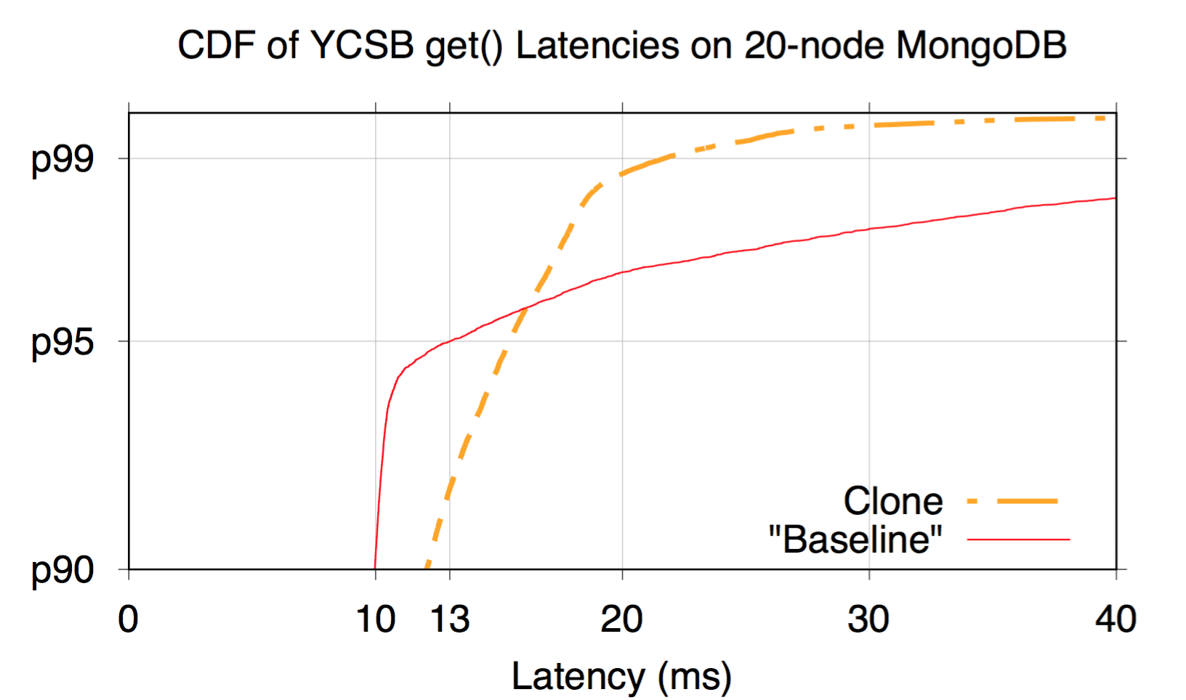
Clone
Tail reduction
Worse performance < p95
Notes:
Next let’s look at Cloning, the orange dash line. By picking the faster response, cloning can effectively reduce the tail. However, it also increases workload on the cluster to 2x, resulting in worse performance below p95.
18sec
Total: 1530s

Slide 38
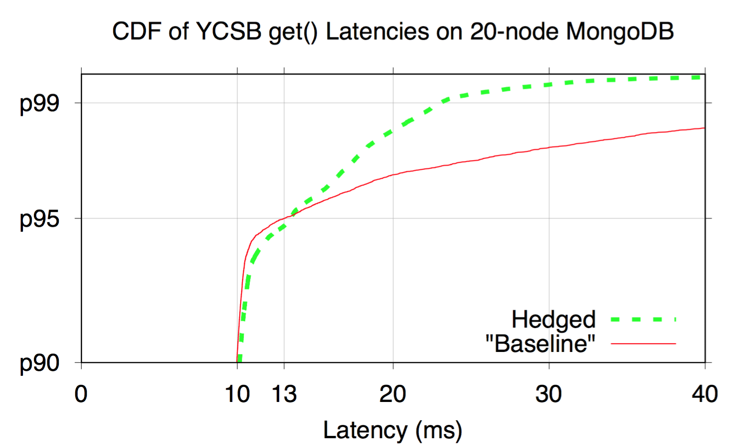
Hedged Requests
Wait
Secondary
Tail reduction
Hedged Requests
1. Sends first req.
2. Waits for timeout
3. Sends second req.
Little extra workload
4. Picks faster resp.
Industrial approach in “Tail At Scale”
Notes:
Next is the hedging. Hedged requests is an industrial approach mentioned in “tail at scale” article from Google. What it does is, sends the first request, waits for 13ms timeout, then sends secondary request, and picks the faster response.
Compared with Cloning, hedging does not significantly increases the load, but efficiently cuts the tail. However, as a reactive method, hedged still needs to wait for timeout first before sending secondary request.
19sec
Total: 1566s

Slide 39
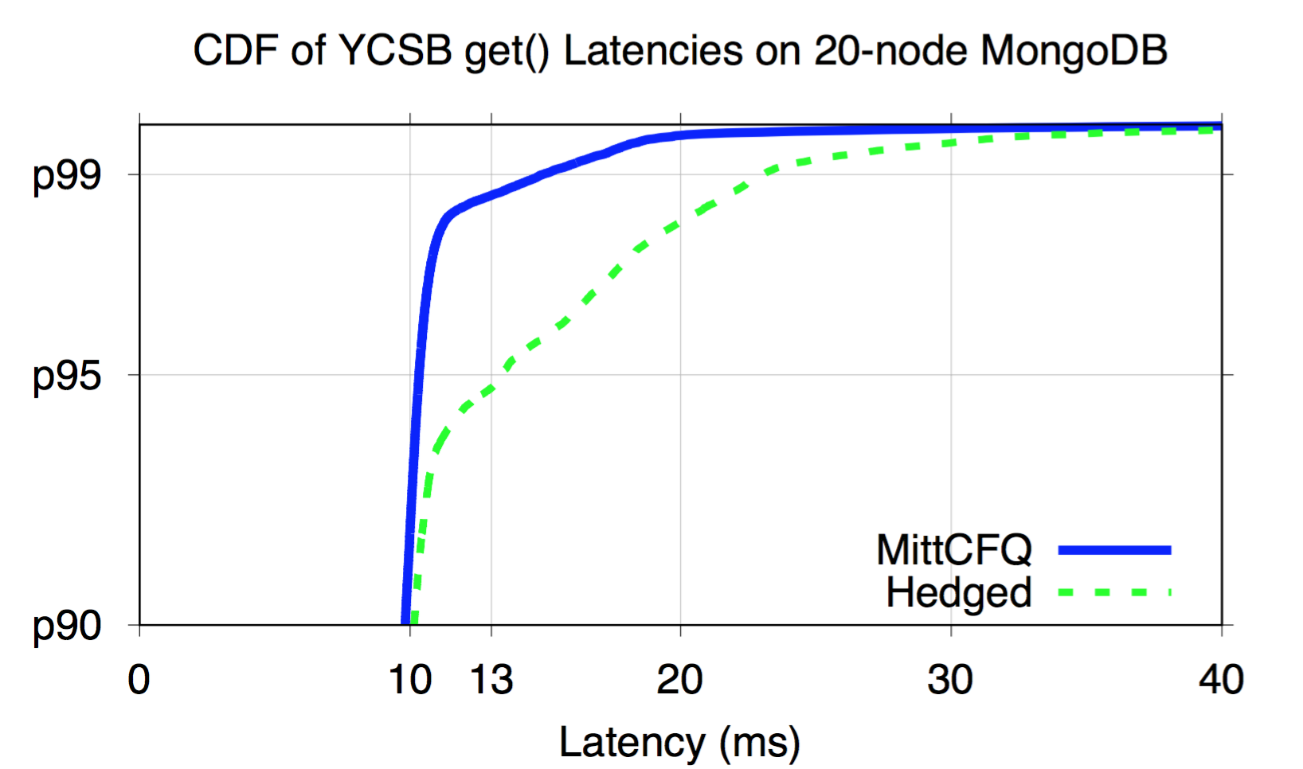
MittCFQ
Wait
Secondary
Failover
Cut ms tail!
Fast
reject
No-wait wins!
Notes:
Eventually our no-wait approach, MittCFQ, the blue line, is able to outperform and cut millisecond-tail.
Why? The reason is that instead of taking expensive waiting, our approach can do fast rejection and failover without waiting.
So again no-wait wins and achieves more cut on the tail than industrial approaches.
25sec
Total: 1591s

Slide 40
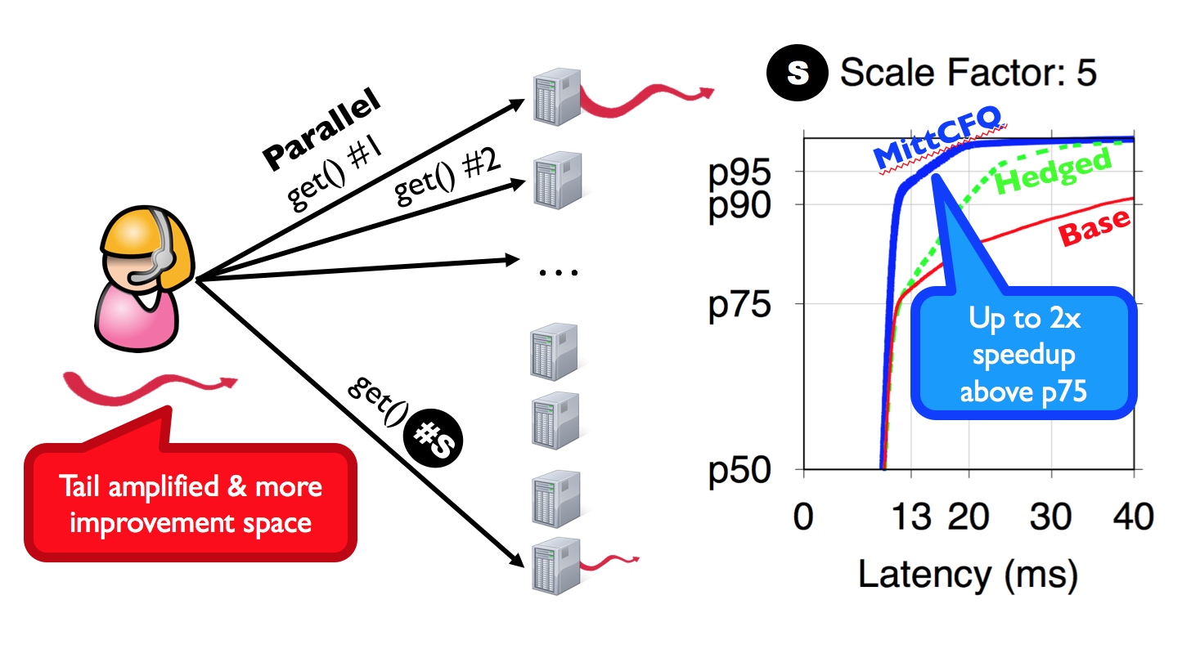
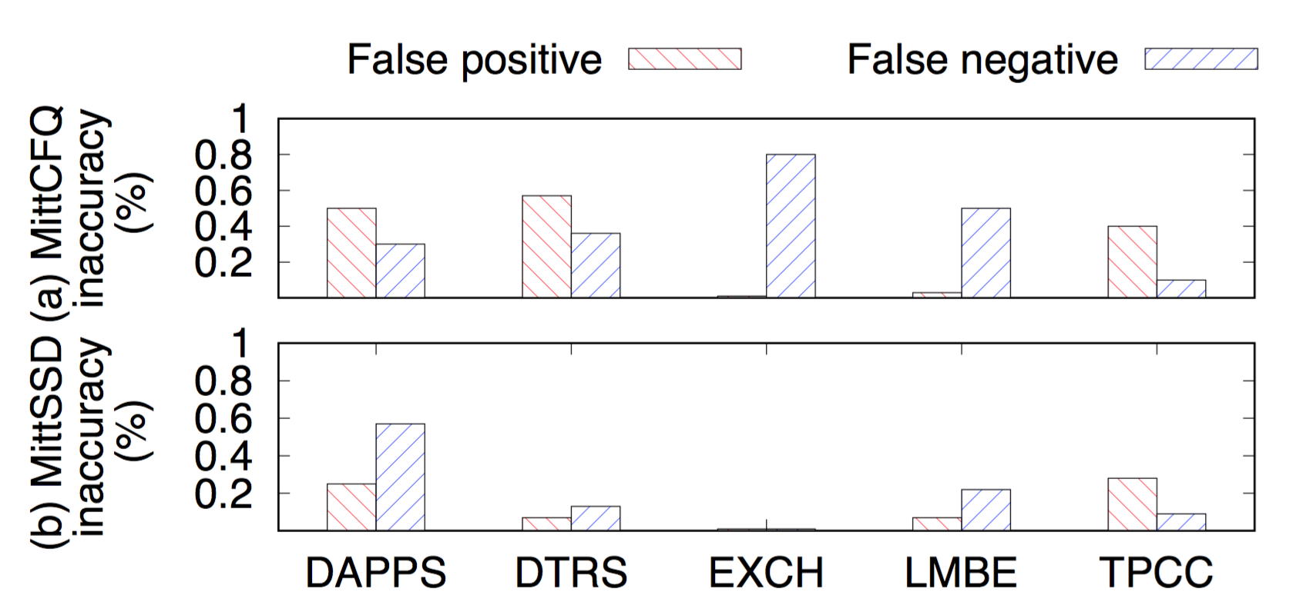
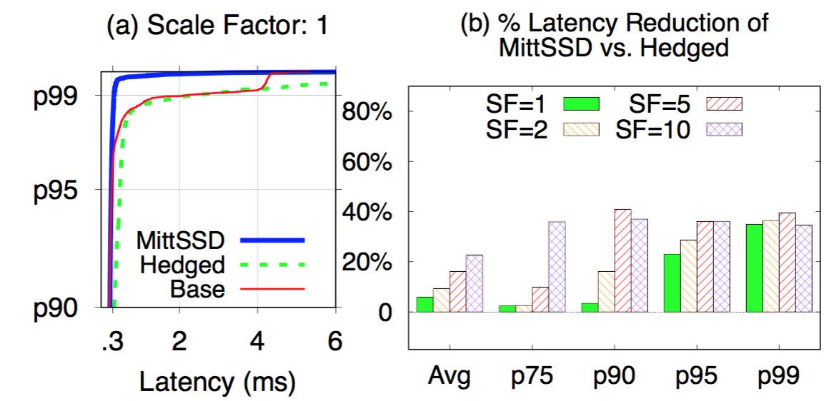
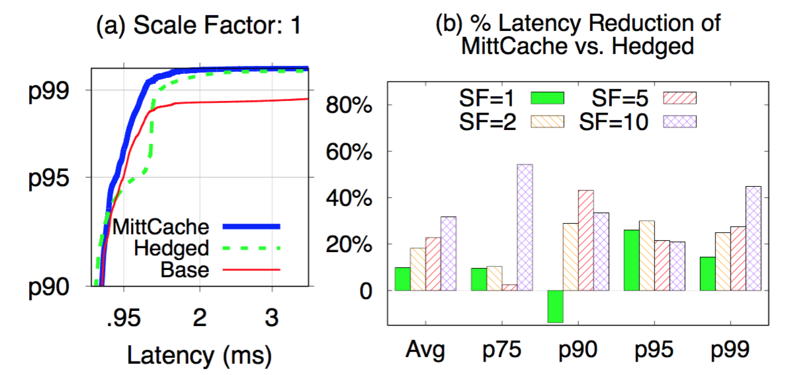
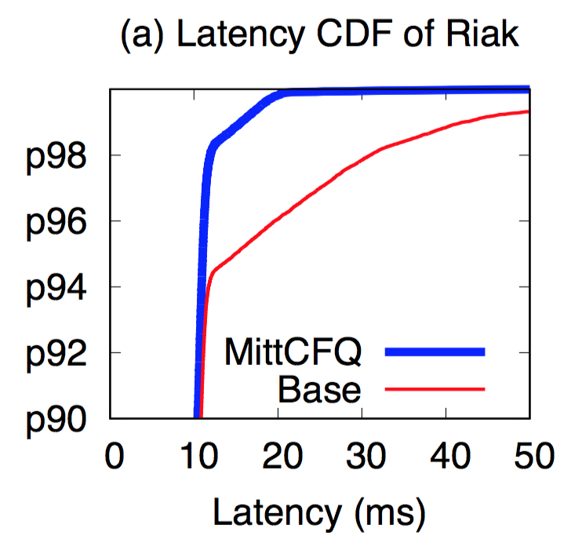
More savings on larger tasks
High accuracies
MittSSD cuts tail
MittCache cuts tail
Supports other applications
Notes:
For the reason of time, I will do a quick pass here.
As nowadays tasks are usually composed of multiple sub-requests. MittOS can save more tail for these tasks(, with up to 2x speedup above p75).
MittOS achieves great accuracy, with (<1% inaccuracies and) minor deviations.
We conduct evaluations for MittSSD and MittCache, and basically got same observations.
And other applications like Riak can easily benefit from MittOS as well.
49sec
Total: 1640s

Slide 41
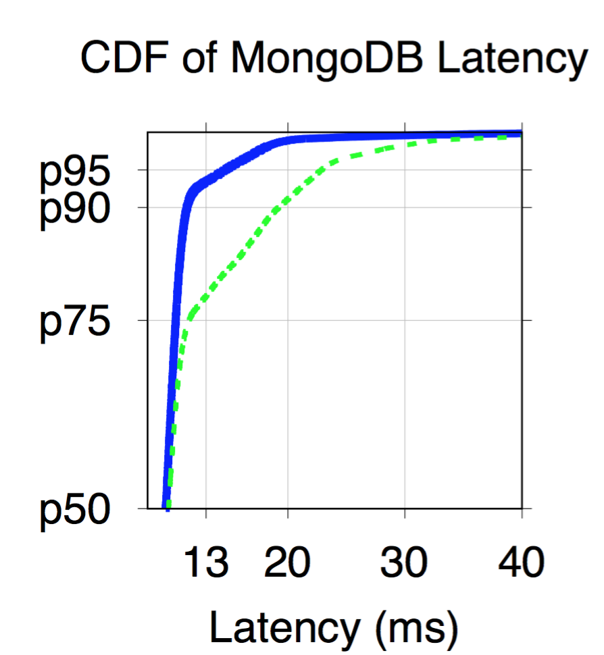
Summary
Clients
Cuts ms/μs tail!
DC
OS
DC
OS
DC
OS
DC
OS
DC
OS
MittOS
DC-Aware OS
Machines
MittOS
State of art
Apps
…
CDF
Fast Reject No-wait Interface
Performance Transparency
MittOS Latency Prediction
Latency
Notes:
As summary, as we have entered datacenter era, our OS should become datacenter aware.
To achieve that, MittOS advocates performance transparency and offers fast rejecting interface for applications to leverage, backed by latency prediction on different resource schemes.
This interface can be easily exploited by applications like MongoDB and Riak, and help them cut milli- or micro- second tail.
20sec
Total: 1660s

Slide 42
Machine Learning for Operating Systems Predicting Per I/O Latency on Commodity SSDs
Notes:
Now I will introduce how I use ML to extend MittOS to support more types of commodity SSDs.
(First, please allow me to put a disclaimer: I am not a machine learning expert and this is a to-submit work, so the designs and solutions here might not be the optimal. I just want to make it clear.)
30s
Subsection total: 30

Slide 43

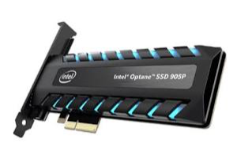
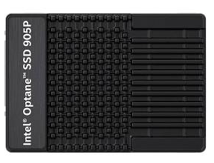
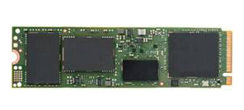
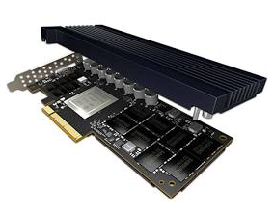
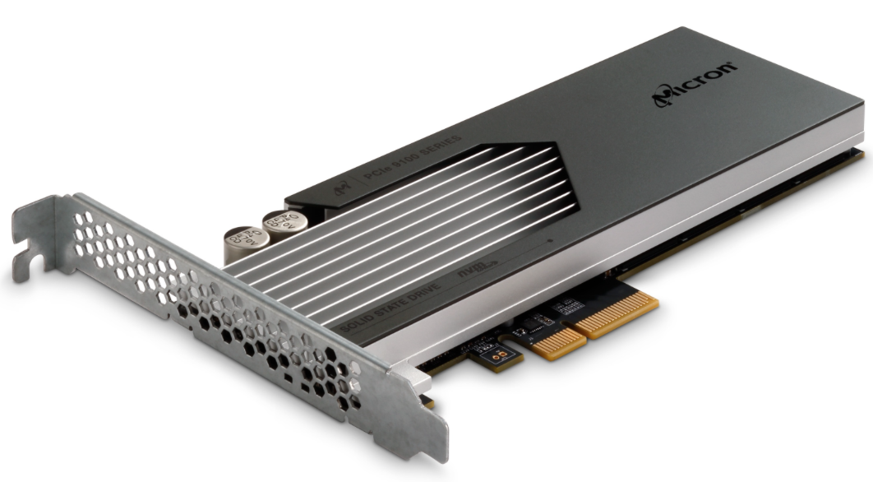
Not All SSDs Are “Open”
SSD deployments
“Open”
Non-“Open”
MittOS cuts ms/μs tail!
We deploy “open” SSDs! MittOS can help!
…
…
Notes:
When I advertised MittOS to datacenter runners, they said: ”Great! We indeed are deploying open SSDs in our setup, and MittOS can help.”
That makes me really excited, (especially as I find that these open SSDs are deployed at many companies such as Alibaba, Baidu, Facebook, Google, Microsoft, Tencent etc.. Perfect! )
So I reached out to take a closer look into their SSD deployments, and here is what I have found.
Yes, there are open SSDs, but there are much, much, much more commodity ones that are black-boxes, which MittOS does not support.
43s
Total: 73s

Slide 44
Per I/O Prediction On More Devices
SSD deployments
“Open”
Non-“Open”
Used for extreme performance
Supported by MittOS
Used for general cases
…
Not covered by MittOS
MittOS needs to support
per-I/O prediction on commodity SSDs
…
Notes:
And when I ask about this. They said: ” we mostly deploy Open SSDs where extreme performance is needed, while for general cases, we tend to use regular SSDs.”
That means, if MittOS wants to further spread its advantage (and help make data centers tail-free), it needs to be able to predict tail latencies at per-I/O level for commodity SSDs.
28s
Total: 101s

Slide 45
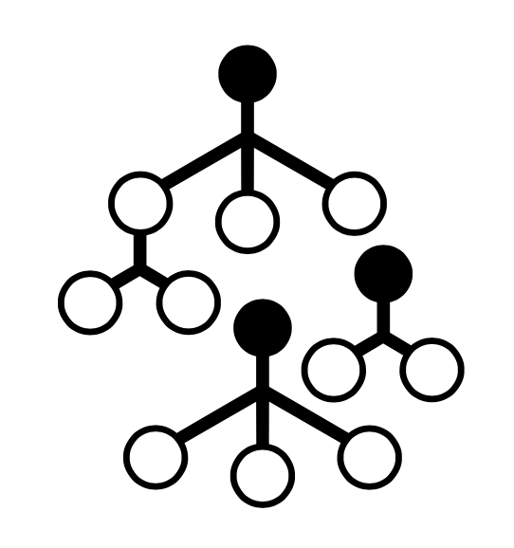

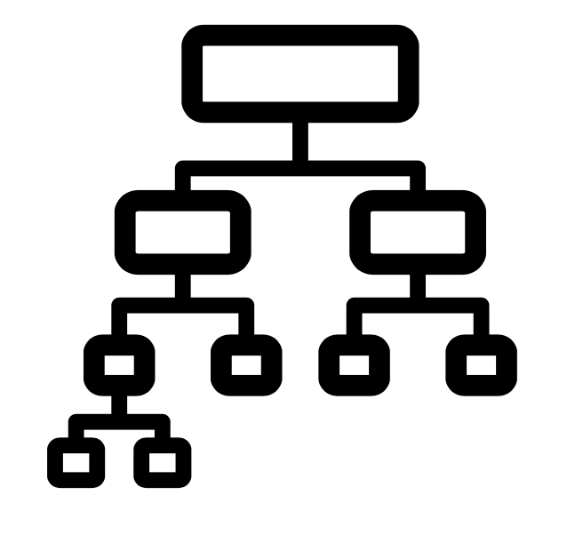
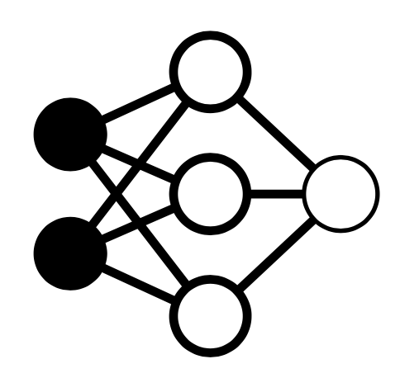
Current SSD Tail-Prediction Approaches
1. ML-based
2. Heuristic-based
Good accuracies
Too coarse for per I/O prediction
Aggregate
Input
Models
Output
Average req. rate,
Average req. size,
Read/write-ratios,
…
Average latencies,
Throughput,
Potential bottlenecks,
…
…
Notes:
So how do current work do this(predict abnormal latencies in SSDs)? As these SSDs are complex to predict, people have tried different techniques.
In general there are two classes. The first one is using ML-based mechanisms,
where people input workload characteristics such as average rate, average size and read-write ratios, to ML models like regression trees, random forests and neural networks, to infer performance metrics like average latencies, throughput, the potential bottlenecks.
The accuracies are good, however, as we see, these metrics are aggregate, (as they are mostly average, )and thus are too coarse for per-IO cases.
49s
Total: 150s

Slide 46
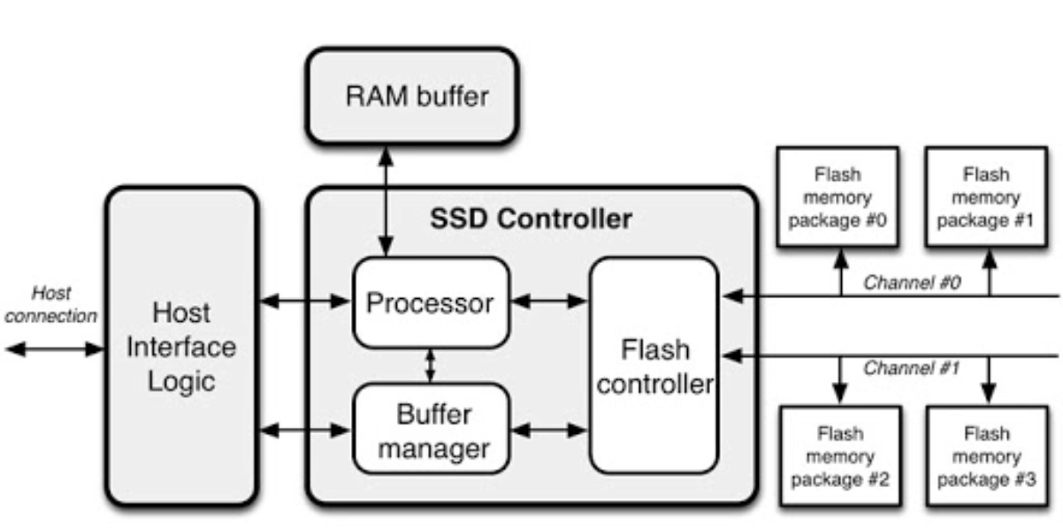
Current SSD Tail-Prediction Approach
1. ML-based
2. Heuristic-based
Support per I/O prediction
Cannot cover all SSD properties (e.g. garbage collections)
Timing of flushes,
and affected I/Os
Observable properties:
Write buffer,
Internal parallelism,
Read/write unit,
…
Patterned
workloads
Notes:
The second one is to use heuristic to probe observable SSD properties that can cause abnormal behaviors, such as write buffer, internal parallelism, and read/write unit.
For example, by using patterned workloads, we can extract the write buffer size (inside the SSDs). With that, we can infer the timing of flushes and subsequent disturbance, and know which I/Os may be affected.
Mechanisms like this do support predictions at per-IO granularity. However, as SSDs are complex, we cannot probe every property, and thus can miss many tails.
45s
Total: 195s

Slide 47
MLOS Approach
Good accuracies for per I/O prediction
App
MLOS
Focus
Immediate disturbance?
No
f ( SSD )
I/O
SSD heuristic
Yes
ML diagnose
…
Reject
Notes:
(So can we have a solution that can generically achieve high accuracies at per I/O basis?
Yes we can, )
Here, we suggest that it is possible to have machine learning and heuristic work together, and combine the advantages of them.
To be specific, when an IO arrives at the OS, the OS can first quickly judge whether this IO would be facing an immediate disturbance based on known SSD properties. If not, then OS can utilize ML for further diagnoses.
Due to time limitation, next I will focus on the ML part, and then briefly talk about how it can be facilitated by SSD-based heuristics.
47s
Total: 242s

Slide 48
ML/OS Objectives
Predicting tail at per I/O basis
1. Good accuracy
2. Low prediction overhead
SSDs are fast.
Prediction needs to be much faster (<10 μs)
Notes:
Overall, to help predict tail at per I/O basis for general SSDs. The ML part needs to achieve two objectives.
First, essentially, it should be accurate.
(Shrink) Second, we need low prediction overhead, since (we are doing predictions for )SSDs offer rapid responses, and ideally we want it to be with in 10 microseconds.
30s
Total: 272s

Slide 49
Towards Accuracy
Maps I/Os to channels/chips based on offsets
Predicting tail at per I/O basis
1. Good accuracy
FTL
2. Low prediction overhead
Fast?
Busy?
Most helpful
Per-IO predictions require per-IO input
For each IO:
Offsets,
Sizes,
Latencies…
Notes:
And these two objectives do introduce significant challenges. Let’s first take a look from the accuracy perspective.
To do per-IO prediction, the model needs input at per-IO level as well. So what do we have? Here inside OS, (the block device layer can provide ) we have metadata of each IO, including their offsets, and sizes etc..
And here the most important ones are the offsets. Why? Because, as we just saw, the SSD uses FTL to decide (which channel or chip each IO goes to) where each IO goes to, and how much contention it will face, and the input to this FTL are basically the offsets.
48s
Total: 320s

Slide 50
Towards Accuracy
0x1234, 0x5678, 0x….
Target I/O
Other pending I/Os
Predicting tail at per I/O basis
1,2,3,4, 5,6,7,8, ….
1. Good accuracy
Input features (up to 2k)
2. Low prediction overhead
Input
List of Offsets
(Hex or binary)
Linear (y = wx+b)
99.8% accuracy
Hundreds of μs latency
Activation
…
Expensive!
Linear (y = wx+b)
For each IO:
Offsets,
Sizes,
Latencies...
8 hidden layers
~512 neurons/layer
Activation
Output (Reject? 0/1)
Notes:
So we use the offsets of target and other pending IOs as input. We put these offsets in heximal or binary formats, and split individual digits into different features for easier reference. And this setting totally incorporates up to 2k features.
We input these features into a neural network with 8 layers, with roughly 512 neurons per layer, and the output remains the same as MittOS: whether the IO should be rejected or not.
Here, the result does show that the neural network can actually learn the mapping, as it shows almost 100% accuracies on multiple traces( on simulated SSDs).
However, this neural network is very expensive, with hundreds of microseconds per prediction, which makes it impractical for SSD deployments.
(As SSD access latency can be as fast as tens of microseconds, this overhead is too expensive for deployments.)
62s
Total: 382s

Slide 51
Towards Low Overhead
52
12
Pending
page reads
Pending
page writes
Predicting tail at per I/O basis
1. Good accuracy
Indicators for latency
2. Low prediction overhead
10
Pending page reads
when history I/O arrives
Lightweight model cannot digest numerous features
More aggregate setting
Inverse values
20
Pending page writes
when history I/O arrives
2000
For each IO:
Offsets,
Sizes,
Latencies...
Internal
disturbance
Latency of
history I/O (μs)
…(more)
Notes:
With that, we look into the inference overhead perspective.
To make the cost practical, we need to trim the model( towards less layers and neurons). However, as the model goes lightweight, it cannot digest the numerous features derived from the offsets, resulting in low accuracies.
So here, we take a step back. Instead of using offsets, we switch to the IO sizes and latencies, which are a bit more aggregate but cheaper for the model to learn.
And, in this feature setting, when a target IO comes, we first collect how many pending page reads/writes are in the queue, as generally speaking the queue length is a good indicator for the latency.
However, queue lengths do not reflect everything since SSDs can have internal disruptions.
Considering that, we also add the information about history IOs. That is, when an IO comes, we record the queue length, and when it completes, we record its latency. The way they help is, if there are internal blocking operations, then we will see inverse values, such as short queues but long latencies, and larger divergence means more severe and recent internal disturbance.
87s
Total: 469s

Slide 52
Towards Low Overhead
…
12
10
52
20
2000
Pending
reads
Pending
writes
Pending
history
reads
Pending
history
writes
History
latency
Predicting tail at per I/O basis
1. Good accuracy
…
0,0,2,0
0,2,0,0,0
0,0,5,2
0,0,1,2
0,0,1,0
2. Low prediction overhead
Input features (totally 60)
92-98% acc. on read-only
82-89% acc. on read-write
5-6μs latency on CPUs
List of pending I/Os
and history latencies
Input
1 hidden layer
256 neurons
Linear (y = wx+b)
For each IO:
Offsets,
Sizes,
Latencies...
Activation
Output (Reject? 0/1)
Notes:
So overall, we use a more aggregate feature setting with sizes and latencies. (Before passing input to the model) Similarly, we apply some padding for easier inference. In total, there are 60 features.
And the model here is much thinner too, as it only requires one hidden layer with 256 neurons. We have evaluated this setting with multiple industrial workloads on various datacenter SSDs, and the results show that it can reach 92-98% accuracy on read-only traces, and 82-89% on read-write ones, with a very low overhead of 5-6 microseconds on CPUs.
47s
Total: 516s

Slide 53


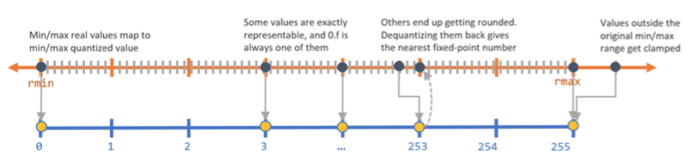
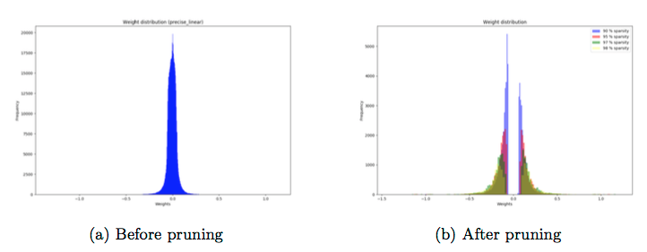
Other Solved Challenges
Neural networks vs. random forests, decision trees
Neural networks bring higher accuracy
ML in kernel-space vs. ML in user-space
Lower overhead to run it inside kernel
Quantization for running ML in OS kernel
Using integer weights with minor accuracy loss
Model pruning to further optimize inference time
vs.
…
OS
…
vs.
Notes:
(Quickly go through this one)
Here allow me to quickly go through some other challenges.
We did compare neural network with other models such as decision trees and random forests, and found that neural network dramatically outperforms.
We run ML in the kernel-space instead of user-space to avoid the software and data movement overhead.
As OS kernel does not explicitly support float, we need to quantize the neural network to use integer weights. We successfully achieve this with minor accuracy loss.
And we are using optimization techniques such as model pruning to further reduce the inference time.
43s
Total: 559s

Slide 54
Evaluation Setup
Industrial SSD traces
as noises
Read-only:
Search engine
…
Read-write:
General cloud storage,
database
Metric:
CDF of all get()
requests latencies
vs. hedging
and baseline
Client #1
Can failover
get()
3 replicas
Node #1
Node #2
Node #3
DC SSDs
…
Notes:
Now let’s take a look at how MLOS can improve the overall system performance.
Here we use a similar setting with MittOS evaluation, but with a smaller setup for initial evaluation, with 3 nodes and 1 client.
Each node is backed by datacenters SSDs, and runs noise generators to replay industrial SSD traces collected from them (, including search engine, cloud storage, database traces etc.. ). Overall, we run both read-only and read-write noises.
Our metric is still the CDF of get latencies from the client. And we compare MLOS with industrial approach hedging, and baseline.
51s
Total: 610s

Slide 55
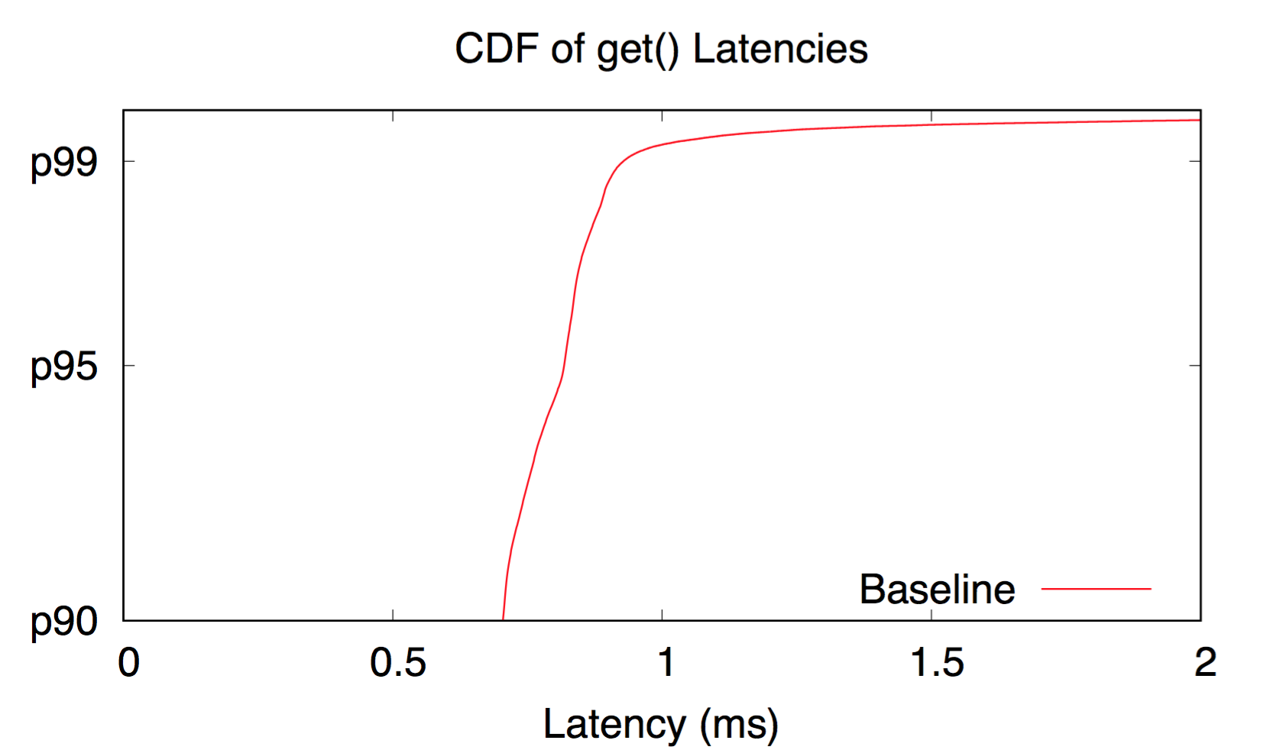
Baseline – in Read-only Scenario
Notes:
Let’s start with the case where all nodes run read-only noises.
Here we see CDF again. The red line is the baseline.
11s
Total: 621s

Slide 56
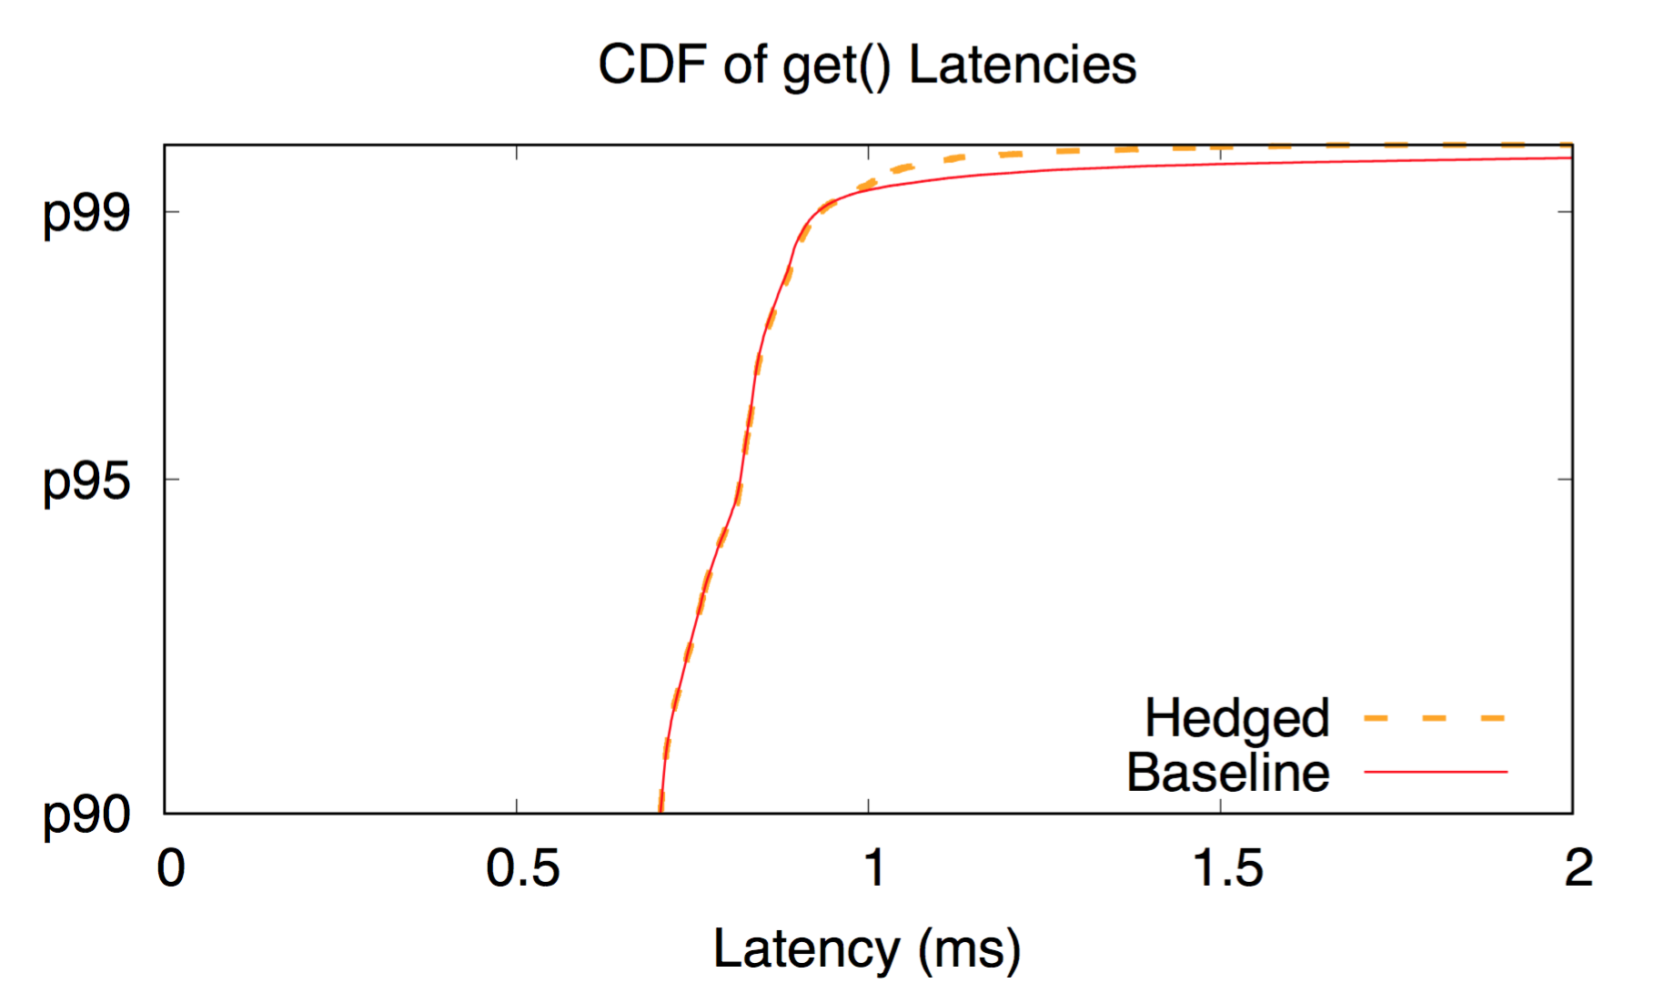
Hedged – in Read-only Scenario
Not much improvement.
Waiting is too expensive!
Notes:
Here shows the result of using hedged requests, the orange dash line. As waiting is extremely expensive in SSD deployments, we don’t see much improvement.
14s
Total: 635s

Slide 57
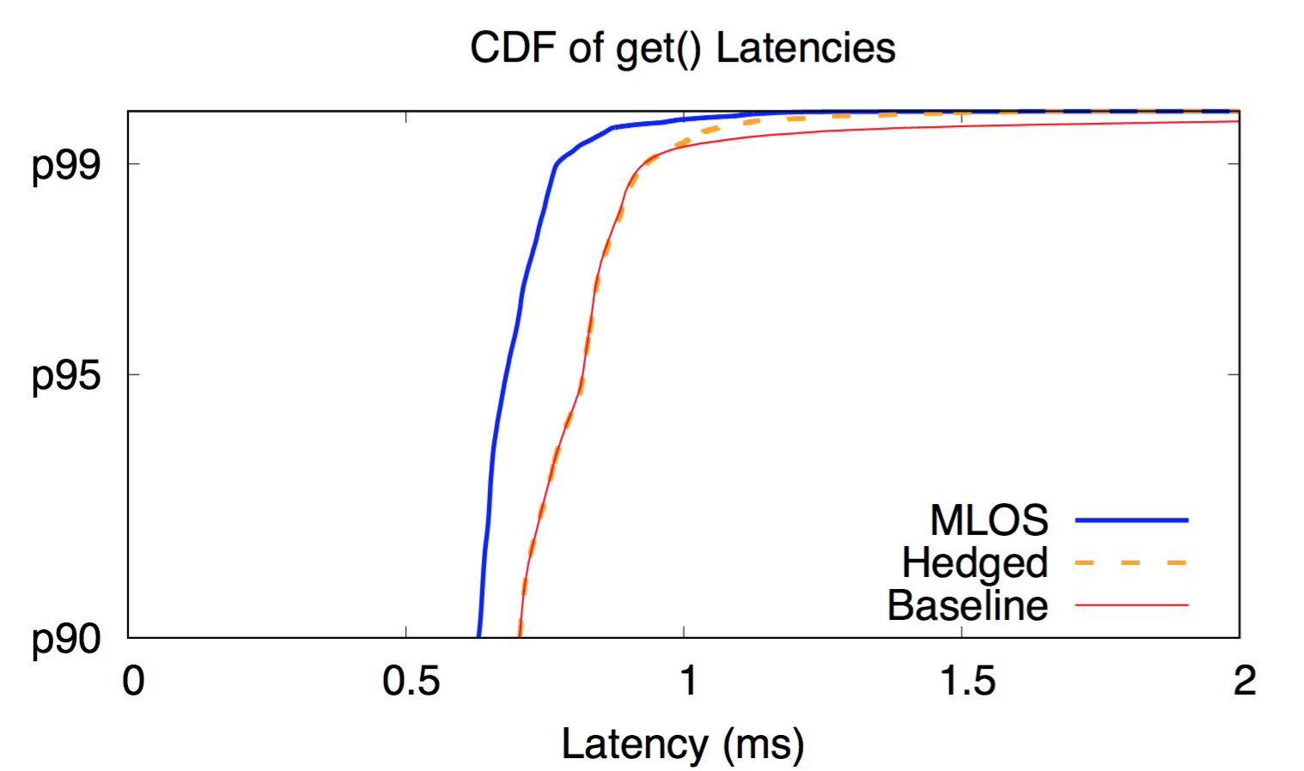
MLOS – in Read-only Scenario
17%
at p99
MLOS cuts
μs-level tail!
MLOS cuts
μs-level tail!
17%
at p95
Notes:
And here is MLOS, the blue line. As shown here, MLOS can outperform hedging by 17% at both p95 and p99, so ML does help make decisions that cut microsecond-level tail.
22s
Total: 657s

Slide 58

MLOS vs. Oracle – in Read-only Scenario
Close to Oracle!
92-98% accuracies.
Notes:
And to see how far is MLOS from the perfect case. We simulate a scenario where there is an oracle learner that can precisely catch every slow response. Green dash line shows the distribution.
Since in read-only scenarios, MLOS can achieve 92-98% accuracies. Here we are not far from the perfect learner.
26s
Total: 683s

Slide 59

Read-write Scenario
More future work
Miss some tails.
Diff
Hedged does not help much
82-89% accuracies
18%
at p95
Notes:
We have seen the read-only scenario. But how about read-write cases, which are more challenging?
Here is the result. As we can see.
First, hedging still does not help much.
Second, MLOS maintains most of its outperformance, with 18% improvement at p95.
However, due to the accuracy, it is a bit away from the oracle. Besides, if we zoom in, we can find that there are tail latencies that we miss, which leaves us more future work.
36s
Total: 719s

Slide 60
ML/OS Summary
92-98% acc. on read-only
82-89% acc. on read-write
5-6 μs overhead on CPU
Aggregate feature setting
+ lightweight neural network
Supports commodity SSDs!
Outperforms industrial approach!
App
MLOS
More future work…
Immediate disturbance?
No
f ( SSD )
I/O
SSD heuristic
Yes
ML diagnose
Reject
Notes:
Let me summarize the ML part we just saw.
By leveraging an aggregate feature setting and a lightweight neural network, (shrink this sentence) the ML part can achieve 92-98% accuracy on real-only workloads, and 82-89% on read-write workloads, with 5-6 microseconds overhead on CPU.
With that, MLOS can support (predictions on) commodity SSDs and outperform industrial approaches. However, it is still away from perfect case, which leaves us more improvement space.

Slide 61
Ongoing effort
App
MLOS
Immediate disturbance?
No
f ( SSD )
I/O
SSD heuristic
Yes
ML diagnose
Reject
Notes:
Next, I will very briefly introduce our ongoing effort on how to use heuristic to facilitate ML towards better predictions.
10s
Total: 761s

Slide 62
Heuristic Reduces Misprediction
Internal buffer flush
Unfavorable I/O sizes
Probes buffer size
and tracks timing
Misses the start timing!
Lack of history!
Hard to learn!
App
MLOS
Scans and memorizes
Immediate disturbance?
No
f ( SSD )
I/O
SSD heuristic
Yes
ML diagnose
Reject
Notes:
There are cases that are difficult for machine learning to catch. For example, when internal buffer just starts to flush and disturb, ML tends to miss some tail due to lack of history. Another scenario is, for some SSD models there are unfavorable I/O sizes that will bring slow responses, and ML cannot catch it without external knowledge.
And things like these are where heuristic can help. As it can probe the buffer size and their flush timings, and extract I/O sizes that SSDs don’t like and memorize them.
25s
Total: 786s

Slide 63


Assembled into heuristics to improve accuracy
Probes 10 properties
of any block-device SSD
Tested on 21 SSD models
Queenie:
SSD probing toolset
App
MLOS
Immediate disturbance?
No
f ( SSD )
I/O
SSD heuristic
Yes
ML diagnose
Reject
Notes:
Considering that, we develop a tool set called Queenie, which can automatically probe 10 performance-related properties of any block-device SSD. We have tested it on 21 SSD models. Due to limited time, I will skip the detail here, but currently we are assembling these probing results into heuristic to further improve the accuracy.
27s
Total: 813s

Slide 64
Summary
Predicts per-IO tail on commodity SSDs!
Outperforms industrial approaches!
App
MLOS
Immediate disturbance?
No
f ( SSD )
I/O
SSD heuristic
Yes
ML diagnose
Reject
Notes:
As a summary, by coming machine learning and heuristic, MLOS can do per-IO tail predictions on commodity SSDs, and outperform the industrial approaches.
17s
Total: 830s

Slide 65
Other Works
Notes:
Now I will very briefly go through some of my other works.

Slide 66






Other Works
Storage
Systems
Cloud
Systems
Semantic-aware model checker for rapid bug discovery
[OSDI ’14], 2nd author
SAMC
Degraded hardware and their cascading impacts
FEMU
Limplock
[SoCC ’13], 2nd author
Insights from vital bugs in real deployments
LeapIO
CloudBug
[SoCC ’14], 2nd author
Availability landscape of modern services
CloudOutage
[SoCC ’16], alphabetically sorted
Notes:
(quickly go through this one)
I have done works in cloud systems. For example, in SAMC, we develop a semantic aware model checker to speed up deep bug discovery.
In Limplock, we collect the anecdotes of degraded hardware components and highlight their cascading impacts on system performance.
In CloudBug study, we study thousands of vital bugs in real deployments and derive numerous interesting insights.
And In Cloud Outage study, we analyze hundreds of unplanned outages and reveal the availability landscape of modern services.

Slide 67




Other Works
Storage
Systems
Cloud
Systems
SAMC
Flash emulator to foster full-stack SSD research
FEMU
Limplock
[FAST ’18], 2nd author
Offloading costly storage services to ARM chips
LeapIO
CloudBug
[ASPLOS ’20], 2nd author
CloudOutage
Notes:
(quickly)
There are another couple of works on storage systems.
In FEMU, we develop a cheap, accurate, scalable and extensible flash emulator to foster full-stack SSD research.
And in LeapIO, we leverages ARM-based co-processors to offload costly storage services and save datacenter running cost.

Slide 68
Future Work
Notes:
Now I will spend the last couple of minutes on my future work.

Slide 69
ML for Storage
OS-level Approach
Coarse policies-makings,
Real-time decisions
ML-for-system
decision making
Hardware-level Approach
ML to guide utilizing
hardware devices
Data Approach
How ML should co-exist
with heuristic?
Notes:
One future direction is to further explore how ML can help systems do decision making, starting from ML-for-storage. We just saw that ML can substantially contribute within such a tiny time window.
With that, there must be a lot of other things that ML can do, for both coarse policies and real-time decisions.
Also as nowadays we have more and more powerful I/O devices, how to use ML to help better utilize these hardware for our storage applications is another thing that I want to look into.
Of course, that does not mean we should put away heuristic. Heuristic is powerful and has been helping us in the recent decades, and we just saw one possibility of making ML and heuristic work together towards a comprehensive solution.
However, there is still no clear guidance on how they should collaborate, which needs a continuous, iterative, and large-scale study of existing works.
55s

Slide 70
Storage for ML
Channels for exchanging performance information
OS-level Approach
(e.g., data access patterns in
large batching, shuffling in ML)
…
Real-time
transparency
Hardware-level Approach
Near-data computation/ML
support through hardware
Data Approach
How to best coordinate
these layers?
Notes:
Also, I want to further pursue my research on building fast and stable storage for various applications, and I would like to start with storage-for-ML.
We have just seen in MittOS about how transparency can help layers work together. Here I want to further promote the necessity of having a channel for layers to exchange performance-related information.
For example, nowadays many apps have explicit knowledge about their data access patterns, such as ML which has large batching, shuffling etc.
As these operations cannot always be fulfilled by memory, I believe that if they have a channel to share these patterns in fine granularity, then OS can take proactive actions to help.
Also, as near data computation/ML is becoming more popular, applications may directly talk with the hardware. In this case, how to provide support directly through these devices is another interesting topic.
Of course, how to best coordinate these layers needs to be based on a good understanding of the data accesses, where I can use my data approach.
72s

Slide 71
Conclusion
“Tail-free” achieved!
Goal: Fast and stable data and storage systems
ML-for-system Approach
OS-level Approach
Hardware-level Approach
Future Work:
ML for Storage,
Storage for ML
Data Approach
Notes:
To conclude, I build future fast and stable data and storage systems at different levels, including OS, hardware and user-level software, and I take data, hardware-level, OS-level, and ML-for-system approaches to reach that future. With these approaches, I make the systems “tail-free”, and in future I would like to work on ML for storage, and storage for ML.

Slide 72
Acknowledgement
Advisors and colleagues:
H. Gunawi, A. Chien, H. Hoffmann, H. Li, R. Suminto,
J. Lukman, T. Leesatapornwongsa, X. Lin, T. Emami…
Advisees:
Chrisma Pakha
Worked on MittOS
PhD student @ CMU
Anqi Zhang
Worked on accuracy aspect in MLOS
PhD student @ NYU
Olivia Weng
Works on overhead optimization in MLOS
Publishes at AccML Workhop
PhD Offer @ Princeton, UCSD...
MittOS/Queenie/MLOS
Nanqinqin Li
Works on Queenie
FAST ’20 submission with top-10 overall merit
PhD Offer @ Princeton, PSU, UCSD…
Anne Farrell
“Trades accuracy for overall performance
in ML-for-Storage solutions”
PhD Defense @ UChicago
Notes:
Before ending, please allow me to add an acknowledgement note.
During my graduate study, there are many people to thank, my advisors, professors in my committee, my colleagues, but I in particular would like to acknowledge some students whom I have supervised:
Chrisma Pakha, who helped on MittOS project, is now a PhD student @ CMU.
Anqi Zhang, who worked on accuracy aspect in MLOS, is pursuing her PhD @ NYU.
Nanqinqin Li, who works on Queenie, has it as his first first-author submission to FAST ’20. The overall merit of this submission is within the top 10, but got rejected, but now he is happy as he has got a Phd offer from here.
Olivia Weng, who works on optimizing the overhead of MLOS, has published her work at AccML workshop, and she recently received her PhD offer from Princeton and UCSD.
And Anne Farrell is participating in MLOS as part of her PhD defense thesis @ UChicago.
86s
Total: 916s
15.3min

Slide 73
Thank you! Questions?
Goal: Fast and stable data and storage systems
ML-for-system Approach
OS-level Approach
Hardware-level Approach
Future Work:
ML for Storage,
Storage for ML
Data Approach

